Slide 1
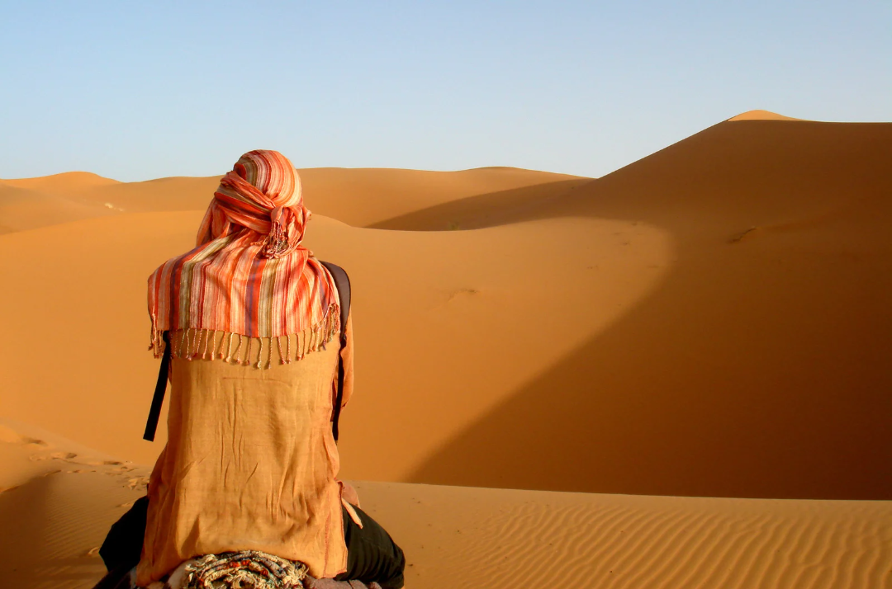
in preparation for:
1st Sunday
Lent 2023
JESUS

Slide 2
GATHER
JESUS
Take a moment to introduce yourself
and greet each other.
We pause for a moment
to prepare to listen to God’s Word
in preparation for:
1st Sunday
Lent 2023

Slide 3
HEAR
We listen now to words from the Gospel of Matthew [Mt4:1-11]
“
JESUS
Jesus was led by the Spirit out into the wilderness to be tempted by the devil. He fasted for forty days and forty nights, after which he was very hungry, and the tempter came and said to him, ‘If you are the Son of God, tell these stones to turn into loaves.’ But he replied, ‘Scripture says: People do not live on bread alone but on every word that comes from the mouth of God.’
The devil then took him to the holy city and made him stand on the parapet of the Temple. ‘If you are the Son of God’ he said ‘throw yourself down; for scripture says: He will put you in his angels’ charge, and they will support you on their hands in case you hurt your foot against a stone.’
Jesus said to him, ‘Scripture also says: You must not put the Lord your God to the test.’
Next, taking him to a very high mountain, the devil showed him all the kingdoms of the world and their splendour. ‘I will give you all these’ he said, ‘if you fall at my feet and worship me.’ Then Jesus replied, ‘Be off, Satan! For scripture says: You must worship the Lord your God, and serve him alone.’
Then the devil left him, and angels appeared and looked after him.
in preparation for:
1st Sunday
Lent 2023
”

Slide 4
REFLECT
Jesus was led by the Spirit out into the wilderness to be tempted by the devil. He fasted for forty days and forty nights, after which he was very hungry, and the tempter came and said to him, ‘If you are the Son of God, tell these stones to turn into loaves.’ But he replied, ‘Scripture says: People do not live on bread alone but on every word that comes from the mouth of God.’
The devil then took him to the holy city and made him stand on the parapet of the Temple. ‘If you are the Son of God’ he said ‘throw yourself down; for scripture says: He will put you in his angels’ charge, and they will support you on their hands in case you hurt your foot against a stone.’
Jesus said to him, ‘Scripture also says: You must not put the Lord your God to the test.’
Next, taking him to a very high mountain, the devil showed him all the kingdoms of the world and their splendour. ‘I will give you all these’ he said, ‘if you fall at my feet and worship me.’ Then Jesus replied, ‘Be off, Satan! For scripture says: You must worship the Lord your God, and serve him alone.’
Then the devil left him, and angels appeared and looked after him.
JESUS
in preparation for:
1st Sunday
Lent 2023
What is staying with you after hearing the scriptures?
In what ways is Jesus a person of Hope in the reading?

Slide 5
REFLECT
JESUS
in preparation for:
1st Sunday
Lent 2023
What are you noticing about the image?

Slide 6
REFLECT
JESUS
The Spirit led Jesus into the wilderness - Where might the Spirit be leading you now?
Where are the desert places in your own life experiences? Where are the desert places in your local area?
in preparation for:
1st Sunday
Lent 2023

Slide 7
pray
This week our time of prayer invites us to be still and use our imagination...
JESUS
Come to a place of stillness in your body and allow your mind to empty for a while...
Spend a few moments picturing a desert scene… the silence… the heat… the wildness… the lack of…
Find somewhere to place yourself in this scene… notice how you feel… what thoughts begin to strike you?...
Now, imagine Jesus coming to sit beside you… take some time just to be in his presence…
Is there anything you want to say… or share.. or ask Jesus? Take a moment to do this….
What does Jesus say in reply? Does he have a message of hope for you?...
Now leave the desert behind and bring your awareness back to the room…
Is there something you want to take with you from the time of prayer?
in preparation for:
1st Sunday
Lent 2023
We give thanks for our time of prayer as we say: Glory be to the Father, and to the Son, and to the Holy Spirit, as it was in the beginning, is now and ever shall be, world without end. Amen.

Slide 8
act
Having listened to the Scriptures, yourself and each other, as well as encountering God in prayer, is there something you feel you might do in response?
JESUS
Choose a line from the Scriptures to pray with this week.
Having noticed the desert places in your area, how might you respond?
How can you build Hope inspired by the person of Jesus?
in preparation for:
1st Sunday
Lent 2023

