Slide 1
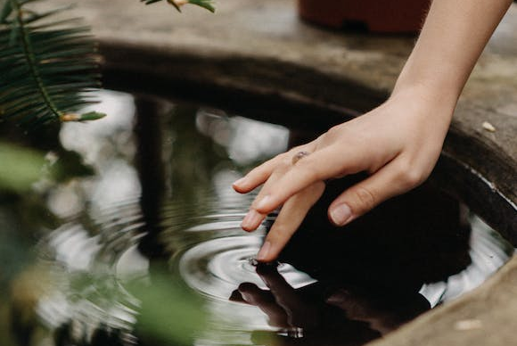
in preparation for:
3rd Sunday
Lent 2023
SAMARITAN WOMAN

Slide 2
GATHER
SAMARITAN
WOMAN
Take a moment to greet each other and share anything that has stayed with you since last week.
We pause for a moment
to prepare to listen to God’s Word
in preparation for:
3rd Sunday
Lent 2023

Slide 3
HEAR
We listen now to words from the Gospel of John
[Jn4:5-7, 9-11, 13-15,25-26,39]
“
SAMARITAN
WOMAN
Jesus came to the Samaritan town called Sychar, near the land that Jacob gave to his son Joseph. Jacob’s well is there and Jesus, tired by the journey, sat straight down by the well. It was about the sixth hour. When a Samaritan woman came to draw water, Jesus said to her, ‘Give me a drink.’ The Samaritan woman said to him, ‘What? You are a Jew and you ask me, a Samaritan, for a drink?’ – Jews, in fact, do not associate with Samaritans. Jesus replied: ‘If you only knew what God is offering and who it is that is saying to you: Give me a drink, you would have been the one to ask, and he would have given you living water.’
‘You have no bucket, sir,’ she answered ‘and the well is deep: how could you get this living water? Jesus replied: ‘Whoever drinks this water will get thirsty again; but anyone who drinks the water that I shall give will never be thirsty again: the water that I shall give will turn into a spring inside him, welling up to eternal life.’ ‘Sir,’ said the woman ‘give me some of that water, so that I may never get thirsty and never have to come here again to draw water.’
The woman said to him, ‘I know that Messiah – that is, Christ – is coming; and when he comes he will tell us everything.’
‘I who am speaking to you,’ said Jesus ‘I am he.’
Many Samaritans of that town had believed in him on the strength of the woman’s testimony.
in preparation for:
3rd Sunday
Lent 2023
”

Slide 4
REFLECT
Jesus came to the Samaritan town called Sychar, near the land that Jacob gave to his son Joseph. Jacob’s well is there and Jesus, tired by the journey, sat straight down by the well. It was about the sixth hour. When a Samaritan woman came to draw water, Jesus said to her, ‘Give me a drink.’ The Samaritan woman said to him, ‘What? You are a Jew and you ask me, a Samaritan, for a drink?’ – Jews, in fact, do not associate with Samaritans. Jesus replied: ‘If you only knew what God is offering and who it is that is saying to you: Give me a drink, you would have been the one to ask, and he would have given you living water.’
‘You have no bucket, sir,’ she answered ‘and the well is deep: how could you get this living water? Jesus replied: ‘Whoever drinks this water will get thirsty again; but anyone who drinks the water that I shall give will never be thirsty again: the water that I shall give will turn into a spring inside him, welling up to eternal life.’ ‘Sir,’ said the woman ‘give me some of that water, so that I may never get thirsty and never have to come here again to draw water.’
The woman said to him, ‘I know that Messiah – that is, Christ – is coming; and when he comes he will tell us everything.’
‘I who am speaking to you,’ said Jesus ‘I am he.’
Many Samaritans of that town had believed in him on the strength of the woman’s testimony.
SAMARITAN
WOMAN
in preparation for:
3rd Sunday
Lent 2023
What is staying with you after hearing the scriptures?
In what ways is the Samaritan Woman a person of Hope in the reading?

Slide 5
REFLECT
SAMARITAN
WOMAN
in preparation for:
3rd Sunday
Lent 2023
What are you noticing about the image?

Slide 6
REFLECT
SAMARITAN
WOMAN
The woman is thirsting for more than water: What are your hopes for your relationship with Jesus?
The woman’s testimony inspires others to believe in Jesus: who are the people you can bring the message of Jesus to? What is the message you would bring?
in preparation for:
3rd Sunday
Lent 2023

Slide 7
pray
This week our time of prayer invites us to speak to Jesus, the source of life...
SAMARITAN
WOMAN
The response after each intention is:
Jesus, Messiah, BE THE source of MY LIFE
When I am tired by the journey of life...
When I take the time I need to rest...
When I encounter people I struggle to get on with…
When I take the risk of asking for help…
When others reach out for my help…
When I struggle to believe in God’s promises and providence…
When I encounter God in the meeting of another person…
When I have the opportunity to witness to God…
(Take a moment now to invite anyone in the group to offer an intention,
after which we can use the response.)
in preparation for:
3rd Sunday
Lent 2023
We give thanks for our time of prayer as we say: Glory be to the Father, and to the Son, and to the Holy Spirit, as it was in the beginning, is now and ever shall be, world without end. Amen.

Slide 8
act
Having listened to the Scriptures, yourself and each other, as well as encountering God in prayer, is there something you feel you might do in response?
SAMARITAN
WOMAN
When will you make time for an encounter with Jesus this week?
In what ways can you help to honour how precious water is to people and the planet?
How can you build Hope inspired by the Samaritan woman?
in preparation for:
3rd Sunday
Lent 2023

