Slide 1
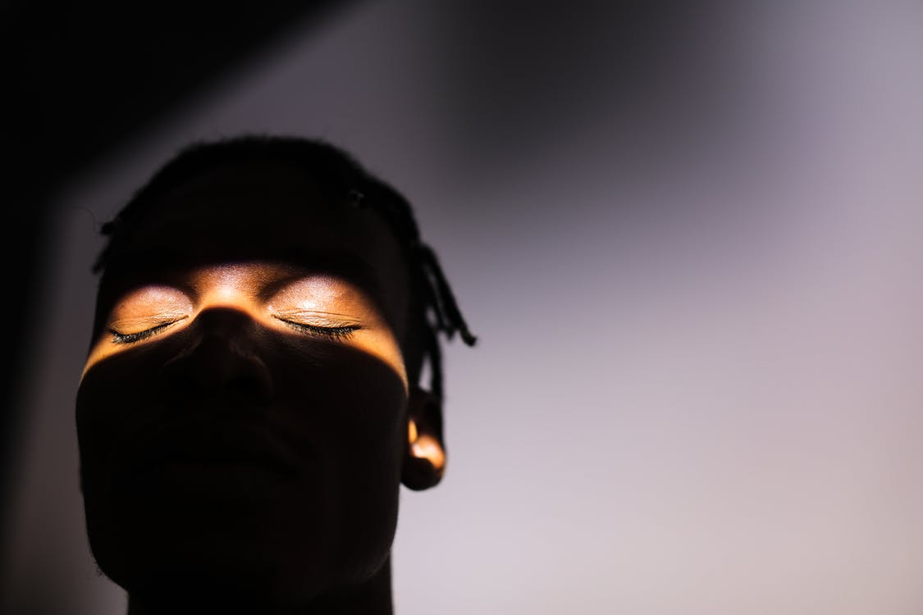
in preparation for:
4th Sunday
Lent 2023
BLIND MAN

Slide 2
GATHER
BLIND
MAN
Take a moment to greet each other and share anything that has stayed with you since last week.
We pause for a moment
to prepare to listen to God’s Word
in preparation for:
4th Sunday
Lent 2023

Slide 3
HEAR
We listen now to words from the Gospel of John [Jn9:1,6-9,13-17,34-38]
“
BLIND
MAN
As Jesus went along, he saw a man who had been blind from birth. He spat on the ground, made a paste with the spittle, put this over the eyes of the blind man, and said to him, ‘Go and wash in the Pool of Siloam’ (a name that means ‘sent’). So the blind man went off and washed himself, and came away with his sight restored.
His neighbours and people who earlier had seen him begging said, ‘Isn’t this the man who used to sit and beg?’ Some said, ‘Yes, it is the same one.’ Others said, ‘No, he only looks like him.’ The man himself said, ‘I am the man.’
They brought the man who had been blind to the Pharisees. It had been a sabbath day when Jesus made the paste and opened the man’s eyes, so when the Pharisees asked him how he had come to see, he said, ‘He put a paste on my eyes, and I washed, and I can see.’ Then some of the Pharisees said, ‘This man cannot be from God: he does not keep the sabbath.’ Others said, ‘How could a sinner produce signs like this?’ And there was disagreement among them. So they spoke to the blind man again, ‘What have you to say about him yourself, now that he has opened your eyes?’ ‘He is a prophet’ replied the man.
‘Are you trying to teach us,’ they replied ‘and you a sinner through and through, since you were born!’ And they drove him away.
Jesus heard they had driven him away, and when he found him he said to him, ‘Do you believe in the Son of Man?’ ‘Sir,’ the man replied ‘tell me who he is so that I may believe in him.’ Jesus said, ‘You are looking at him; he is speaking to you.’ The man said, ‘Lord, I believe’, and worshipped him.
in preparation for:
4th Sunday
Lent 2023
”

Slide 4
REFLECT
As Jesus went along, he saw a man who had been blind from birth. He spat on the ground, made a paste with the spittle, put this over the eyes of the blind man, and said to him, ‘Go and wash in the Pool of Siloam’ (a name that means ‘sent’). So the blind man went off and washed himself, and came away with his sight restored.
His neighbours and people who earlier had seen him begging said, ‘Isn’t this the man who used to sit and beg?’ Some said, ‘Yes, it is the same one.’ Others said, ‘No, he only looks like him.’ The man himself said, ‘I am the man.’
They brought the man who had been blind to the Pharisees. It had been a sabbath day when Jesus made the paste and opened the man’s eyes, so when the Pharisees asked him how he had come to see, he said, ‘He put a paste on my eyes, and I washed, and I can see.’ Then some of the Pharisees said, ‘This man cannot be from God: he does not keep the sabbath.’ Others said, ‘How could a sinner produce signs like this?’ And there was disagreement among them. So they spoke to the blind man again, ‘What have you to say about him yourself, now that he has opened your eyes?’ ‘He is a prophet’ replied the man.
‘Are you trying to teach us,’ they replied ‘and you a sinner through and through, since you were born!’ And they drove him away.
Jesus heard they had driven him away, and when he found him he said to him, ‘Do you believe in the Son of Man?’ ‘Sir,’ the man replied ‘tell me who he is so that I may believe in him.’ Jesus said, ‘You are looking at him; he is speaking to you.’ The man said, ‘Lord, I believe’, and worshipped him.
BLIND
MAN
in preparation for:
4th Sunday
Lent 2023
What is staying with you after hearing the scriptures?
In what ways is the Blind Man a person of Hope in the reading?

Slide 5
REFLECT
BLIND
MAN
in preparation for:
4th Sunday
Lent 2023
What are you noticing about the image?

Slide 6
REFLECT
BLIND
MAN
When have been the moments in your life where you have been enabled to let go of a ‘blindness’ or to see more in the way God sees?
Jesus opened the blind man’s eyes so he could truly see the world and what was important. What do you need to open your eyes to in your local area or in the world?
in preparation for:
4th Sunday
Lent 2023

Slide 7
pray
This week our time of prayer invites us to be aware of what and how we see...
BLIND MAN
Take a moment to sit with your feet firmly on the ground… sit upright… and place your hands on your knees…
In silence, with your eyes open… become aware of your surroundings… what is in the room?... who is in the room?... what draws your attention?... Take a moment to be with God in this...
Now slowly close your eyes… you may want to cover your eyes with your hands if that helps… what are you aware of now you can’t see?... are you noticing anything different?... what draws your attention now?... Take another moment to be with God in this?...
Now uncover or open your eyes… try to hold on to the experience of being without your sight… take time to become familiar again with what you see… do you notice anything different?... have you any new insights?... Take another moment to be with God in this?...
Is there a prayer… an intention… something to be thankful for… that you want to speak to God about?... Have some time to do that now...
in preparation for:
4th Sunday
Lent 2023
We give thanks for our time of prayer as we say: Glory be to the Father, and to the Son, and to the Holy Spirit, as it was in the beginning, is now and ever shall be, world without end. Amen.

Slide 8
act
Having listened to the Scriptures, yourself and each other, as well as encountering God in prayer, is there something you feel you might do in response?
BLIND MAN
Think of something you are struggling with and see if you can look at it in a new way.
Having thought about what you could open your eyes to, what can you do to make a difference?
How can you build Hope inspired by the person of the Blind Man?
in preparation for:
4th Sunday
Lent 2023

