Slide 1
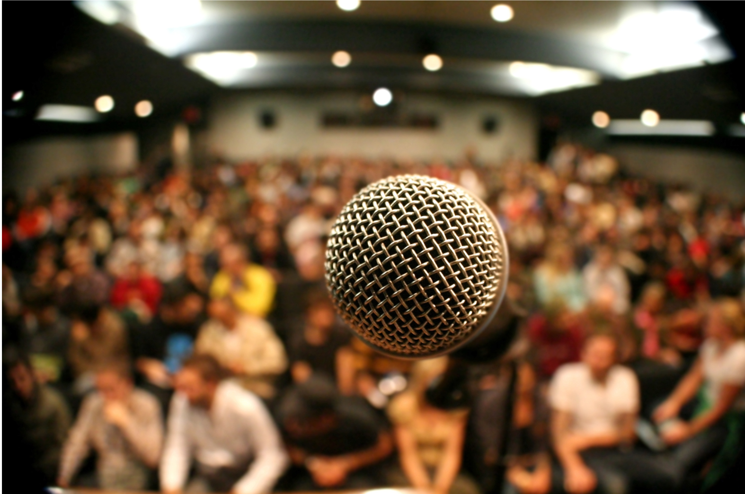
in preparation for:
Palm Sunday
Lent 2023
US

Slide 2
GATHER
US
Take a moment to greet each other and share anything that has stayed with you since last week.
We pause for a moment
to prepare to listen to God’s Word
in preparation for:
Palm Sunday
Lent 2023

Slide 3
HEAR
We listen now to words from the prophet Isaiah Is50:4-7]
“
US
The Lord has given me
a disciple’s tongue.
So that I may know how to reply to the wearied
he provides me with speech.
Each morning he wakes me to hear,
to listen like a disciple.
The Lord has opened my ear.
For my part, I made no resistance,
neither did I turn away.
I offered my back to those who struck me,
my cheeks to those who tore at my beard;
I did not cover my face
against insult and spittle.
The Lord comes to my help,
so that I am untouched by the insults.
So, too, I set my face like flint;
I know I shall not be shamed.
in preparation for:
Palm Sunday
Lent 2023
”

Slide 4
REFLECT
The Lord has given me
a disciple’s tongue.
So that I may know how to reply to the wearied
he provides me with speech.
Each morning he wakes me to hear,
to listen like a disciple.
The Lord has opened my ear.
For my part, I made no resistance,
neither did I turn away.
I offered my back to those who struck me,
my cheeks to those who tore at my beard;
I did not cover my face
against insult and spittle.
The Lord comes to my help,
so that I am untouched by the insults.
So, too, I set my face like flint;
I know I shall not be shamed.
US
in preparation for:
Palm Sunday
Lent 2023
What is staying with you after hearing the scriptures?
In what ways is Isaiah a person of Hope in the reading?

Slide 5
REFLECT
US
in preparation for:
Palm Sunday
Lent 2023
What are you noticing about the image?

Slide 6
REFLECT
US
What are the things that prevent you from being a disciple and speaking out in faith?
Isaiah’s description of discipleship reminds us of the person of Jesus. Who are the people you know of, personally or from the media, who fit this description?
in preparation for:
Palm Sunday
Lent 2023

Slide 7
pray
This week our time of prayer invites us to reflect on a different Creed...
US
As we approach this Holy Week, we pause to think about what the events of these coming days mean to what we believe...
We believe in God, who made the sun and the sky, the stars and the sea, who calls us to live responsibly.
We believe in Jesus Christ, who became human, who healed the sick, who talked to children, who made friends with sinners. He burned brightly and offended many. His journey was one of life and death and resurrection. His light continues to shine in darkness.
We believe that God calls us to be community, committed to one another, offering a welcome to everyone, old and young, rich and poor, strong and weak.
We believe that God calls us to be peacemakers, workers for justice, brothers and sisters, a light for our world. Amen.
(Written by two 14 year olds at a worship workshop on Iona)
in preparation for:
Palm Sunday
Lent 2023
We give thanks for our time of prayer as we say: Glory be to the Father, and to the Son, and to the Holy Spirit, as it was in the beginning, is now and ever shall be, world without end. Amen.

Slide 8
act
Having listened to the Scriptures, yourself and each other, as well as encountering God in prayer, is there something you feel you might do in response?
US
What will you do to help make this Holy Week holy?
Try to write your own version of a Creed or Statement of Faith.
How can you inspire other people to build Hope?
in preparation for:
Palm Sunday
Lent 2023

