Slide 1
WELCOME!
This evening we will get the chance to explore
a Toolkit for Leaders:
Understand more what the resource is about and who it is for
Learn about Small Groupwork and Faith Sharing
Look at the Structure of the ‘People of Hope’ resource
View one of the sessions and how it might run
Practical ideas and suggestions for making it work
Have a chance to ask questions and make comments
Small group faith sharing resource for LENT 2023

Slide 2
Small group faith sharing resource for LENT 2023

Slide 3
LENT 2023
The Season of Lent is a really good time for reflection and to devote time to our faith life. Following a process like this helps to maintain the sense and integrity of a liturgical season.
It’s a very simple and easy way to offer something to people during Lent and can be run in conjunction with any other Lenten initiative parishes may have.
The ‘People of Hope’ resource is here to support people and parishes as we move forward pastorally in the Building Hope initiative in the Diocese.
It also helps to grow and strengthen the synodal way of being Church that, under the guidance of Pope Francis, we have already started to develop.
Small group faith sharing resource for LENT 2023

Slide 4
Why a small faith community approach?
To grow in confidence about sharing our faith in Jesus.
To create safe spaces for those who are searching and questioning
To enable and empower people to take on a leadership role in facilitating faith sharing through experience.
To respond to our baptismal call and to become more co-responsible members of the Church
To help build community.
Suitable for everyone!
Small group faith sharing resource for LENT 2023

Slide 5
What is Faith sharing?
Remember that Faith Sharing is voluntary. People need to be invited to share; verbal participation is encouraged but not demanded.
Faith Sharing is not interrupted. A good leader enables the group to listen before commenting or speaking. Side conversations are discouraged, generally only one person speaks at a time.
Faith sharing is not contradicted. As sharing is based on the person’s own experience conclusions or critiques of what is shared are not appropriate.
Sharing is always done in ‘I’ language. Good leaders encourage participants to begin with: I think, I felt, I like… rather than Mary said, they think, they feel, people say!
Faith sharing is confidential. What is shared in the group stays in the group. A good leader might encourage insights to be shared with a wider group but always asks the permission of the sharer.
Small group faith sharing resource for LENT 2023

Slide 6
DEBATE
Assumes that there is a right answer and that only some people possess it
Is competitive: Participants attempt to prove the other side wrong
Is about winning
Listens to find flaws
Defends assumptions as truth
Critiques others positions
Defends one’s own view against others
Searches for flaws and weaknesses in others
Seeks a conclusion that ratifies one’s own position
DIALOGUE
Assumes that many people have pieces of the truth and that together we can come to truth
Is collaborative: Participants work together toward common understanding
Is about seeking common ground
Listens to understand, find meanings and agreement
Reveals assumptions for re-evaluation and learning
Re-examines all positions
Admits others’ thinking can improve one’s own
Searches for strength and value in others’ position
Seeks new options, keeps ideas flexible and open
Small group faith sharing resource for LENT 2023

Slide 7
Who is it for?
The resource has been developed to encourage people to gather in small groups to listen and share. These could be:
family groups
groups of friends meeting in someone's house
a group (or groups) meeting in the parish after weekday Mass or in an afternoon or evening.
a gathering online via Zoom!
The resource can be run with any number but experience would suggest that the best group size is about 6 to 8 people. Obviously, if you have more than that you can have more than one small group!
Small group faith sharing resource for LENT 2023

Slide 8
The Six Sessions
The resource uses the scriptures from the Sundays of Lent as inspiration. Ideally, people gather in the lead up to each Sunday so they are more prepared and enriched to experience the liturgies and the season of Lent.
The ’People of Hope’ for the six sessions are: JESUS; PETER, JAMES & JOHN; SAMARITAN WOMAN; BLIND MAN; LAZARUS and US
Each session follows the same format and has a leaflet and PowerPoint resources to guide the process.
Each session lasts approximately between 45 - 60 minutes depending on the size of group. This could be a little longer if you decide to have some simple refreshments.
Small group faith sharing resource for LENT 2023

Slide 9
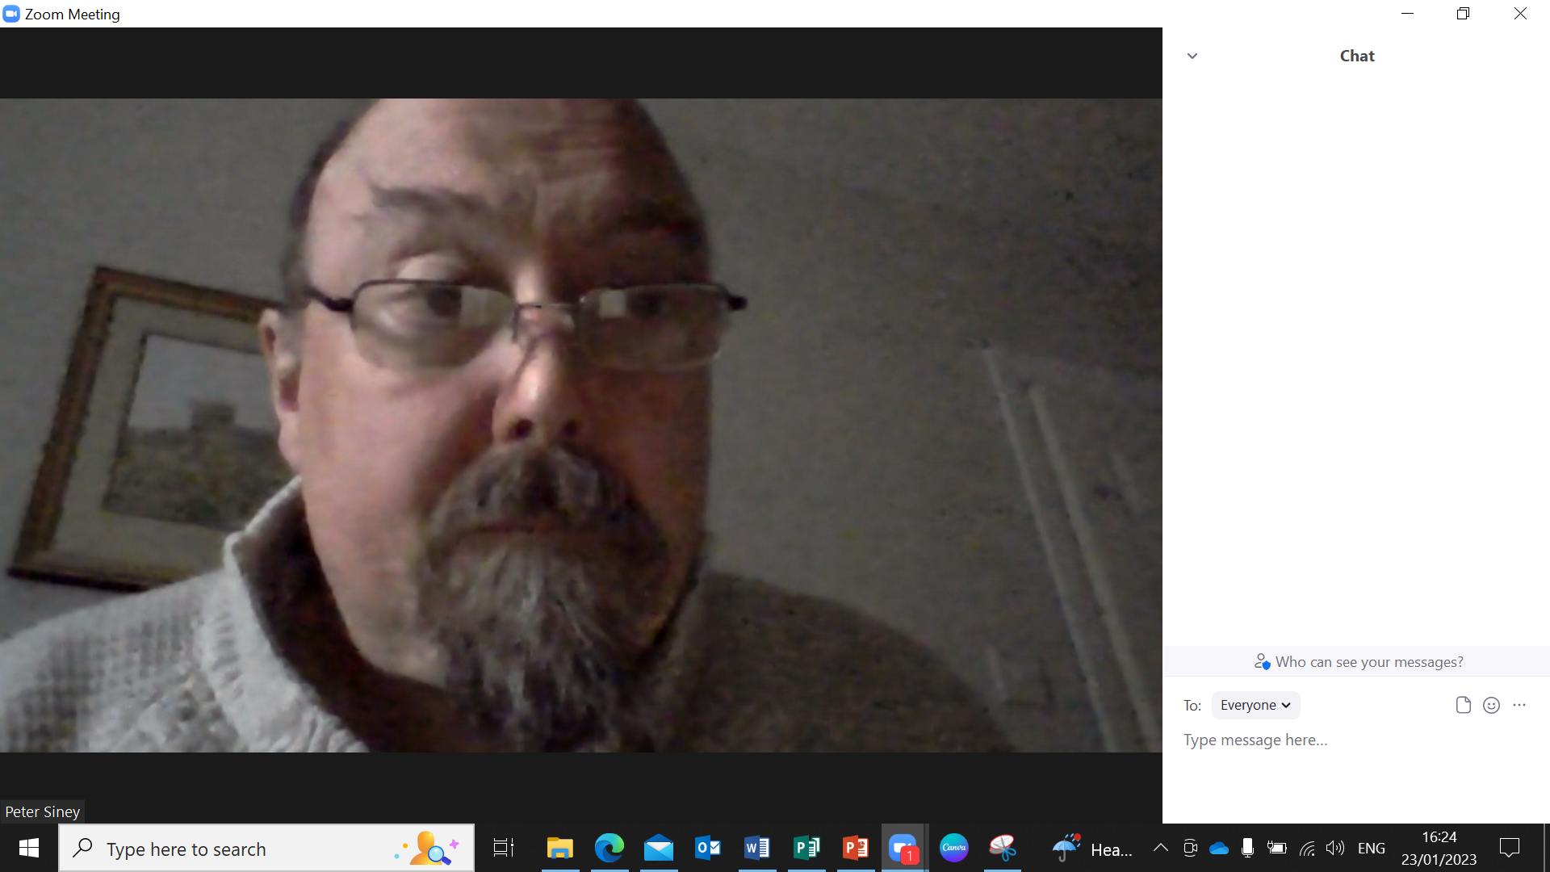
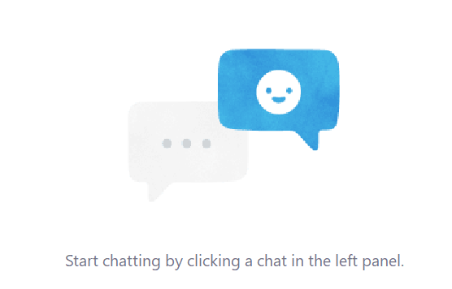
Any thoughts, comments, questions??
Small group faith sharing resource for LENT 2023
Type into the CHAT box here

Slide 10
in preparation for:
4th Sunday
Lent 2023
BLIND MAN

Slide 11
GATHER
BLIND
MAN
Take a moment to greet each other and share anything that has stayed with you since last week.
We pause for a moment
to prepare to listen to God’s Word
in preparation for:
4th Sunday
Lent 2023

Slide 12
HEAR
We listen now to words from the Gospel of John [Jn9:1,6-9,13-17,34-38]
“
BLIND
MAN
As Jesus went along, he saw a man who had been blind from birth. He spat on the ground, made a paste with the spittle, put this over the eyes of the blind man, and said to him, ‘Go and wash in the Pool of Siloam’ (a name that means ‘sent’). So the blind man went off and washed himself, and came away with his sight restored.
His neighbours and people who earlier had seen him begging said, ‘Isn’t this the man who used to sit and beg?’ Some said, ‘Yes, it is the same one.’ Others said, ‘No, he only looks like him.’ The man himself said, ‘I am the man.’
They brought the man who had been blind to the Pharisees. It had been a sabbath day when Jesus made the paste and opened the man’s eyes, so when the Pharisees asked him how he had come to see, he said, ‘He put a paste on my eyes, and I washed, and I can see.’ Then some of the Pharisees said, ‘This man cannot be from God: he does not keep the sabbath.’ Others said, ‘How could a sinner produce signs like this?’ And there was disagreement among them. So they spoke to the blind man again, ‘What have you to say about him yourself, now that he has opened your eyes?’ ‘He is a prophet’ replied the man.
‘Are you trying to teach us,’ they replied ‘and you a sinner through and through, since you were born!’ And they drove him away.
Jesus heard they had driven him away, and when he found him he said to him, ‘Do you believe in the Son of Man?’ ‘Sir,’ the man replied ‘tell me who he is so that I may believe in him.’ Jesus said, ‘You are looking at him; he is speaking to you.’ The man said, ‘Lord, I believe’, and worshipped him.
in preparation for:
4th Sunday
Lent 2023
”

Slide 13
REFLECT
As Jesus went along, he saw a man who had been blind from birth. He spat on the ground, made a paste with the spittle, put this over the eyes of the blind man, and said to him, ‘Go and wash in the Pool of Siloam’ (a name that means ‘sent’). So the blind man went off and washed himself, and came away with his sight restored.
His neighbours and people who earlier had seen him begging said, ‘Isn’t this the man who used to sit and beg?’ Some said, ‘Yes, it is the same one.’ Others said, ‘No, he only looks like him.’ The man himself said, ‘I am the man.’
They brought the man who had been blind to the Pharisees. It had been a sabbath day when Jesus made the paste and opened the man’s eyes, so when the Pharisees asked him how he had come to see, he said, ‘He put a paste on my eyes, and I washed, and I can see.’ Then some of the Pharisees said, ‘This man cannot be from God: he does not keep the sabbath.’ Others said, ‘How could a sinner produce signs like this?’ And there was disagreement among them. So they spoke to the blind man again, ‘What have you to say about him yourself, now that he has opened your eyes?’ ‘He is a prophet’ replied the man.
‘Are you trying to teach us,’ they replied ‘and you a sinner through and through, since you were born!’ And they drove him away.
Jesus heard they had driven him away, and when he found him he said to him, ‘Do you believe in the Son of Man?’ ‘Sir,’ the man replied ‘tell me who he is so that I may believe in him.’ Jesus said, ‘You are looking at him; he is speaking to you.’ The man said, ‘Lord, I believe’, and worshipped him.
BLIND
MAN
in preparation for:
4th Sunday
Lent 2023
What is staying with you after hearing the scriptures?
In what ways is the Blind Man a person of Hope in the reading?

Slide 14
REFLECT
BLIND
MAN
in preparation for:
4th Sunday
Lent 2023
What are you noticing about the image?

Slide 15
REFLECT
BLIND
MAN
When have been the moments in your life where you have been enabled to let go of a ‘blindness’ or to see more in the way God sees?
Jesus opened the blind man’s eyes so he could truly see the world and what was important. What do you need to open your eyes to in your local area or in the world?
in preparation for:
4th Sunday
Lent 2023

Slide 16
pray
This week our time of prayer invites us to be aware of what and how we see...
BLIND MAN
Take a moment to sit with your feet firmly on the ground… sit upright… and place your hands on your knees…
In silence, with your eyes open… become aware of your surroundings… what is in the room?... who is in the room?... what draws your attention?... Take a moment to be with God in this...
Now slowly close your eyes… you may want to cover your eyes with your hands if that helps… what are you aware of now you can’t see?... are you noticing anything different?... what draws your attention now?... Take another moment to be with God in this?...
Now uncover or open your eyes… try to hold on to the experience of being without your sight… take time to become familiar again with what you see… do you notice anything different?... have you any new insights?... Take another moment to be with God in this?...
Is there a prayer… an intention… something to be thankful for… that you want to speak to God about?... Have some time to do that now...
in preparation for:
4th Sunday
Lent 2023
We give thanks for our time of prayer as we say: Glory be to the Father, and to the Son, and to the Holy Spirit, as it was in the beginning, is now and ever shall be, world without end. Amen.

Slide 17
act
Having listened to the Scriptures, yourself and each other, as well as encountering God in prayer, is there something you feel you might do in response?
BLIND MAN
Think of something you are struggling with and see if you can look at it in a new way.
Having thought about what you could open your eyes to, what can you do to make a difference?
How can you build Hope inspired by the person of the Blind Man?
in preparation for:
4th Sunday
Lent 2023

Slide 18
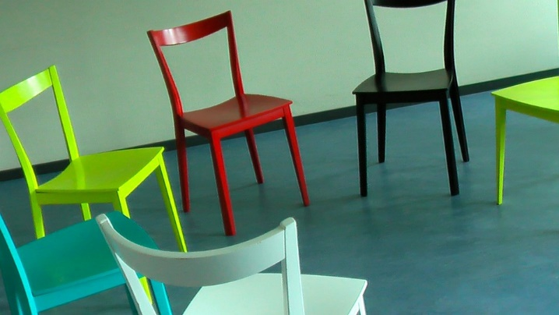
Setting the Scene
The space: Make sure the space is as comfortable as possible.
Arrange the seating into a circle or at least so people are facing each other.
Print off enough leaflets for everyone. Have some pens handy.
If you are using the accompanying recordings or PowerPoints make sure you have the right equipment and that everyone can see the screen.
You might also consider some simple refreshments either before or after the session.
Small group faith sharing resource for LENT 2023

Slide 19
Group Guidelines: Agree a set of guildelines for the group:
Sharing is confidential to the group - people need to ask for permission to share a useful insight with another person or group.
Start and end on time.
Only one person should speak at a time.
During the sharing we listen first before making a response or asking questions.
Encourage the use of ‘I’ language rather than ‘they/he/she’.
Mobiles need to be turned off or on silent.
People should make contact if they’re unable to come - perhaps get contact details for the group or set up a WhatsApp group.
Small group faith sharing resource for LENT 2023

Slide 20
Leading the sharing
This is an invitational process so let people share as much or as little as they are comfortable with.
Don’t be afraid of silence.
Try to ensure that everyone has the chance to talk and no voice dominates the sharing.
Avoid any interruptions/comments/questions while people are sharing - it is more about the respectful and prayerful synodal listening to understand.
Asking questions in an ‘open style’ is more helpful: Who, What Where, Why, When etc..
Don’t feel you have to respond all the time or provide answers to questions but encourage a group dynamic where all feel able to answer or make a response.
Ask for volunteers for tasks like reading to avoid putting people under pressure.
Try to keep an eye on the time so things don’t overrun.
Small group faith sharing resource for LENT 2023

Slide 21
Some Practicalities
Think about how you are going to promote this:
Mass notices/announcements
Parish newsletter
Noticeboards and church doors
Parish website and social media.
Don’t forget that personal invitation works the best!
Will people sign up, register or just turn up?
Where and when will you hold the gathering? Make sure everyone knows!
If there are more people wanting to participate then think about having more than one group. Ideally each group would have someone assigned to lead them. (You may need to train more leaders)
Who will photocopy leaflets/set up PowerPoint/host Zoom?
Refreshments?? Who will provide them?
Small group faith sharing resource for LENT 2023

Slide 22
Resources
Leader’s Toolkit leaflet
Leaflets for the sessions
Powerpoints
Sound files for the Prayer section
are available from the LENT section
of our website
missionministry.ie
To register please email:
peter.siney@dublindiocese.ie
Small group faith sharing resource for LENT 2023

Slide 23
Any thoughts, comments, questions??
Small group faith sharing resource for LENT 2023
Type into the CHAT box here

Slide 24
Thank you
for attending the training.
Hope you find the resource useful and enjoyable!
For any further questions or help please contact
peter.siney@dublindiocese.ie
Small group faith sharing resource for LENT 2023

