Slide 1
WELCOME THE WORD
THIS SUNDAYS THEME
STONES AND BREAD

Slide 2
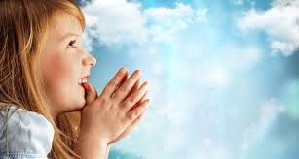
Today is the First Sunday of Lent
We are going to
Listen to God’s Word
Share our thoughts
Pray for each other
Then join our parents in Church
Notes:
NOTE: To change images on this slide, select a picture and delete it. Then click the Insert Picture icon in the placeholder to insert your own image.

Slide 3
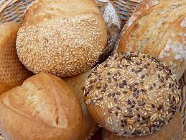
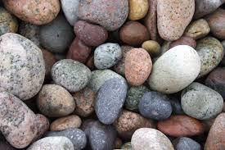
Share which of the two pictures you like most
Bread
Stones
Notes:
NOTE: To change images on this slide, select a picture and delete it. Then click the Insert Picture icon in the placeholder to insert your own image.

Slide 4
A reading from the Gospel of Matthew
As you listen
look out for stones and bread

Slide 5
The Spirit led Jesus into the desert to be tempted by the devil. Jesus ate nothing for 40 days and nights. After this, he was very hungry. The devil came to Jesus to tempt him.
The devil said, “If you’re the Son of God, tell these stones to become bread.”
Jesus answered, “It is written in the Bible, ‘A person doesn’t stay alive only by eating bread. But also lives by everything that God says.’”

Slide 6
Then the devil led Jesus to the holy city of Jerusalem. He put Jesus on a very high place of the Temple.
The devil said, “If you are the Son of God, jump off. God’s word says,
‘He has put his angels in charge of you.
They will catch you with their hands.
And you will not hit your foot on a rock.’”
Jesus answered him, “God’s word also says, ‘Do not test the Lord your God.’”

Slide 7
Then the devil led Jesus to the top of a very high mountain.
He showed Jesus all the kingdoms of the world and all the great things that are in those kingdoms.
The devil said, “If you will bow down and worship me, I will give you all these things.”
Jesus said to the devil,
“Go away from me. God’s word says,
‘You must worship the Lord your God. Serve only him!’”
So the devil left Jesus. And then some angels came to Jesus and helped him.
THE GOSPEL OF THE LORD
PRAISE TO YOU LORD JESUS CHRIST

Slide 8
SHARE
ABOUT THE STORY
Where is Jesus today?
Who is talking to Jesus?
How could stones become bread?
What other false promises does the devil make?
Who looked after Jesus?
Who helped Jesus?
ABOUT US
If you were Jesus what would you say to the devil?
Why is it important to ignore false promises?
Who can we always trust?

Slide 9
LET’S PRAY
FOR OURSELVES
FOR OUR WORLD
When we want to do things our way and not your way
Help us Holy Spirit
When we feel afraid and don’t know what to do
Help us Holy Spirit
When people forget to do the right thing
Help them Holy Spirit
When people get tired of being kind to others
Help them Holy Spirit

Slide 10
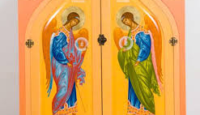
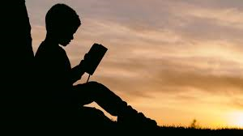
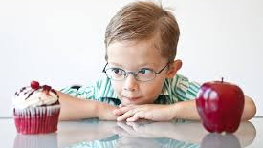
What picture will you remember this week?
Notes:
NOTE: To change images on this slide, select a picture and delete it. Then click the Insert Picture icon in the placeholder to insert your own image.

