Slide 1
WELCOME THE WORD
THIS SUNDAYS THEME
LIGHT AND LOVE

Slide 2
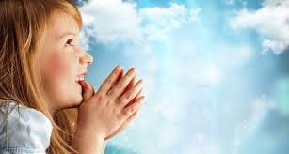
Today is the Second Sunday of Lent
We are going to
Listen to God’s Word
Share our thoughts
Pray for each other
Then join our parents in Church
Notes:
NOTE: To change images on this slide, select a picture and delete it. Then click the Insert Picture icon in the placeholder to insert your own image.

Slide 3


Share which of the two pictures you like most
Love
Light
Notes:
NOTE: To change images on this slide, select a picture and delete it. Then click the Insert Picture icon in the placeholder to insert your own image.

Slide 4
A reading from the Gospel of Matthew
As you listen
look out for light and love

Slide 5
Six days later, Jesus took Peter, James, and John the brother of James up on a high mountain. They were all alone there.
While they watched, Jesus was changed. His face became bright like the sun. And his clothes became white as light. Then two men were there, talking with him. The men were Moses and Elijah.
Peter said to Jesus, “Lord, it is good that we are here. If you want, I will put three tents here—one for you, one for Moses, and one for Elijah.”

Slide 6
While Peter was talking, a bright cloud covered them. A voice came from the cloud. The voice said, “This is my Son and I love him. I am very pleased with him. Obey him!”
The followers with Jesus heard the voice. They were so frightened that they fell to the ground. But Jesus went to them and touched them. He said, “Stand up. Don’t be afraid.”
When the followers looked up, they saw Jesus was now alone.
When Jesus and the followers were coming down the mountain, Jesus commanded them, “Don’t tell anyone about the things you saw on the mountain. Wait until the Son of Man has been raised from death. Then you may tell.”

Slide 7
SHARE
ABOUT THE STORY
Where is Jesus today?
Who is with Jesus in this Gospel story?
What happened when Jesus prayed?
How do you think Peter, James and John felt?
What did Peter say to Jesus?
What did the voice say from the cloud?
ABOUT US
When have you ever been up a high mountain?
What could you see? What was it like?
If you had been on the mountain with Peter, James and John, what would you have said to Jesus ?

Slide 8
LET’S PRAY
FOR OURSELVES
FOR OUR WORLD
When we are feeling sad or alone
Give us the light of your love
When we are running out of energy
Give us the light of your love
When people feel afraid and unsure
Give them the light of your love
When people are sick and unwell
Give them the light of your love

Slide 9
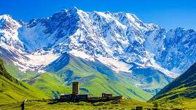
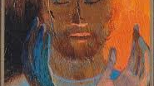
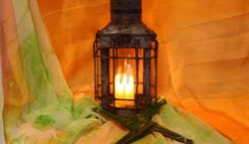
What picture will you remember this week?
Notes:
NOTE: To change images on this slide, select a picture and delete it. Then click the Insert Picture icon in the placeholder to insert your own image.

