Slide 1
WELCOME THE WORD
THIS SUNDAYS THEME
WATER and WELL

Slide 2
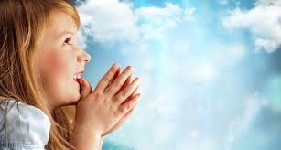
Today is the Third Sunday of Lent
We are going to
Listen to God’s Word
Share our thoughts
Pray for each other
Then join our parents in Church
Notes:
NOTE: To change images on this slide, select a picture and delete it. Then click the Insert Picture icon in the placeholder to insert your own image.

Slide 3
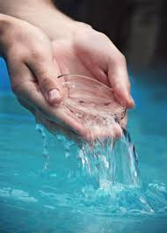
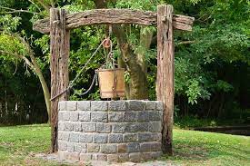
Share which of the two pictures you like most
Water
Well
Notes:
NOTE: To change images on this slide, select a picture and delete it. Then click the Insert Picture icon in the placeholder to insert your own image.

Slide 4
A reading from the Gospel of Matthew
As you listen
look out for water and well

Slide 5
Jesus was tired from his long trip. So he sat down beside the well. It was about noon. A Samaritan woman came to the well to get some water. Jesus said to her, “Please give me a drink.” (This happened while Jesus’ followers were in town buying some food.)
The woman said, “I am surprised that you ask me for a drink. You are a Jew and I am a Samaritan.” (Jews are not friends with Samaritans.)
Jesus said, “You don’t know what God gives. And you don’t know who asked you for a drink. If you knew, you would have asked me, and I would have given you living water.”

Slide 6
The woman said, “Sir, where will you get that living water? The well is very deep, and you have nothing to get water with. Are you greater than Jacob, our father? Jacob is the one who gave us this well. He drank from it himself. Also, his sons and flocks drank from this well.”
Jesus answered, “Everyone who drinks this water will be thirsty again. But whoever drinks the water I give will never be thirsty again. The water I give will become a spring of water flowing inside him. It will give him eternal life.”
The woman said to him, “Sir, give me this water. Then I will never be thirsty again. And I will not have to come back here to get more water.”

Slide 7
SHARE
ABOUT THE STORY
Where is Jesus today in this Gospel?
Where did he stop to rest?
Where were his disciples?
What did he ask the woman?
How did she reply?
What kind of water did Jesus want to give her?
ABOUT US
How many times a day do you drink some water?
When have you ever been really thirsty? What did it feel like?
When have you ever been near living water either at a river or a sea?
What does it sound like and feel like?

Slide 8
LET’S PRAY
FOR OURSELVES
FOR OUR WORLD
When we feel our hearts are empty and we’ve no more love to give
Lord give us living water
When we are tired and grumpy and find it hard to be kind
Lord give us living water
Where people do not have water to drink
Lord give them living water
When people are tired and need rest
Lord give them living water

Slide 9
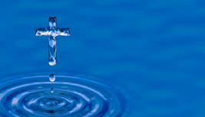
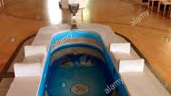
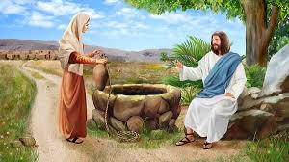
What picture will you remember this week?
Notes:
NOTE: To change images on this slide, select a picture and delete it. Then click the Insert Picture icon in the placeholder to insert your own image.

