Slide 1
WELCOME THE WORD
THIS SUNDAYS THEME
BLIND and OPEN EYES

Slide 2
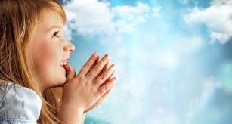
Today is the Fourth Sunday of Lent
We are going to
Listen to God’s Word
Share our thoughts
Pray for each other
Then join our parents in Church
Notes:
NOTE: To change images on this slide, select a picture and delete it. Then click the Insert Picture icon in the placeholder to insert your own image.

Slide 3
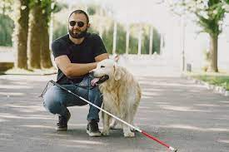
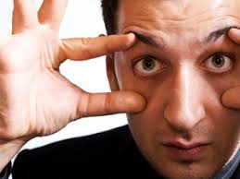
Share which of the two pictures you like most
Blind
Open eyes
Notes:
NOTE: To change images on this slide, select a picture and delete it. Then click the Insert Picture icon in the placeholder to insert your own image.

Slide 4
A reading from the Gospel of Matthew
As you listen
look out for blind and open

Slide 5
As Jesus was walking along, he saw a man who had been born blind
After Jesus said this, he spit on the ground and made some mud with it. He put the mud on the man’s eyes. Then he told the man, “Go and wash in the Pool of Siloam.” (Siloam means Sent.) So the man went to the pool. He washed and came back. And he was able to see.
Some people had seen this man begging before. They and the man’s neighbours said, “Look! Is this the same man who always sits and begs?” Some said, “Yes! He is the one.” But others said, “No, he’s not the same man. He only looks like him.” So the man himself said, “I am the man.”

Slide 6
Then the people took to the Pharisees the man who had been blind. The day Jesus had made mud and healed his eyes was a Sabbath day. So now the Pharisees asked the man, “How did you get your sight?” He answered, “He put mud on my eyes. I washed, and now I can see.”
Some of the Pharisees were saying, “This man does not keep the Sabbath day. He is not from God!” Others said, “But a man who is a sinner can’t do miracles like these.” So they could not agree with each other. They asked the man again, “What do you say about him? It was your eyes he opened.” The man answered, “He is a prophet.”
They answered, “You were born full of sin! Are you trying to teach us?” And they threw the man out.

Slide 7
Jesus heard that they had thrown him out. So Jesus found him and said, “Do you believe in the Son of Man?”
He asked, “Who is the Son of Man, sir? Tell me, so I can believe in him!”
Jesus said to him, “You have already seen him. The Son of Man is the one talking with you now.”
He said, “Yes, Lord, I believe!” Then the man bowed and worshipped Jesus.

Slide 8
SHARE
ABOUT THE STORY
Where is Jesus in this Gospel story?
What did Jesus do for the beggar?
What did others think about the blind man?
Why did they think he had been made blind?
What did Jesus do when the man was thrown out?
How did the man react when Jesus told him he had cured him?
ABOUT US
When have you ever been in a really dark room?
How does it feel when you can’t see in front of you?
If you were blind and Jesus came along and made you better how would you feel and what would you do?

Slide 9
LET’S PRAY
FOR OURSELVES
FOR OUR WORLD
For all our family and friends who are sick Lord reach out and touch them in your love
Lord Jesus heal us all
For those who can’t believe in you, help them to believe
Lord Jesus heal us all
For people who call others names and hurt by their words
Lord Jesus heal us all
For people who are hurting about something and holding on to it
Lord Jesus heal us all

Slide 10
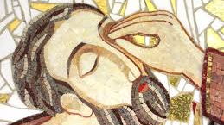
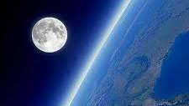

What picture will you remember this week?
Notes:
NOTE: To change images on this slide, select a picture and delete it. Then click the Insert Picture icon in the placeholder to insert your own image.

