Slide 1
WELCOME THE WORD
THIS SUNDAYS THEME
RISE AND LIVE

Slide 2
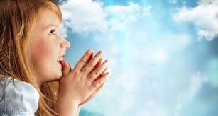
Today is the Fifth Sunday of Lent
We are going to
Listen to God’s Word
Share our thoughts
Pray for each other
Then join our parents in Church
Notes:
NOTE: To change images on this slide, select a picture and delete it. Then click the Insert Picture icon in the placeholder to insert your own image.

Slide 3
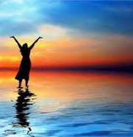
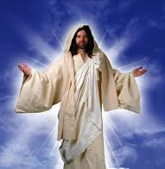
Share which of the two pictures you like most
Rise
Life
Notes:
NOTE: To change images on this slide, select a picture and delete it. Then click the Insert Picture icon in the placeholder to insert your own image.

Slide 4
A reading from the Gospel of Matthew
As you listen
look out for rise and life

Slide 5
So Mary and Martha sent someone to tell Jesus, “Lord, the one you love is sick.”
When Jesus heard this he said, “This sickness will not end in death. It is for the glory of God. This has happened to bring glory to the Son of God.”
Jesus loved Martha and her sister and Lazarus. But when he heard that Lazarus was sick, he stayed where he was for two more days. Then Jesus said to his followers, “Let us go back to Judea.”

Slide 6
Jesus arrived in Bethany. There he learned that Lazarus had already been dead and in the tomb for four days.
Martha heard that Jesus was coming, and she went out to meet him. But Mary stayed at home. Martha said to Jesus, “Lord, if you had been here, my brother would not have died. But I know that even now God will give you anything you ask.”
Jesus said, “Your brother will rise and live again.”

Slide 7
Martha answered, “I know that he will rise and live again in the resurrection on the last day.”
Jesus said to her, “I am the resurrection and the life. He who believes in me will have life even if he dies. And he who lives and believes in me will never die. Martha, do you believe this?”
Martha answered, “Yes, Lord. I believe that you are the Christ, the Son of God. You are the One who was coming to the world.”

Slide 8
SHARE
ABOUT THE STORY
Where is Jesus today in this Gospel?
Why did the sisters call for Jesus?
What did Jesus do when he heard about his friend Lazarus?
How did Jesus respond?
How did Jesus comfort the sisters?
How do you think Martha felt?
ABOUT US
When have you ever helped a friend who is sad?
What words did you say to help?
When has something really amazing happened to you? How did it make you feel?

Slide 9
LET’S PRAY
FOR OURSELVES
FOR OUR WORLD
When we are tired or sad or feeling a bit low Lord give us new life
Lord give us new life
When we get a bit bored with doing the right thing and being kind to others
Lord give us new life
When people see the trees and flowers grow new leaves
Lord give them new life
When we think about those who are sick and need your help
Lord give them new life

Slide 10
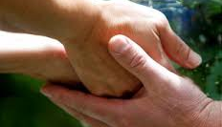
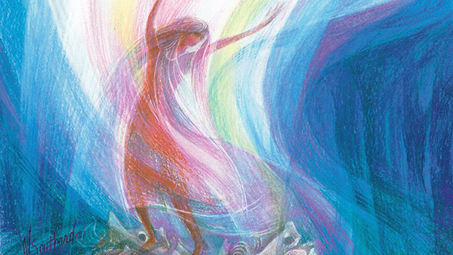
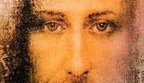
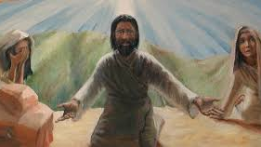

What picture will you remember this week?
Notes:
NOTE: To change images on this slide, select a picture and delete it. Then click the Insert Picture icon in the placeholder to insert your own image.

