Slide 1




Confirmation Connect:
VIDEO 1
Journey in Faith

Slide 2

  We meet at a precious moment in family life
  Approaching Confirmation
  2 half-hour sessions, each with a specially prepared video
  To make the most of this special time
  This first session is ‘Strength for the Journey’
www.missionministry.ie

Slide 3

Format of the Session
  Welcome & Opening Prayer - 5 mins
  Show Video Clip - 5 mins
  Family Chat with Questionns - 10 mins
  Feedback - 5 mins
  Home Activity & Closing Prayer - 5 mins
www.missionministry.ie

Slide 4

Opening Prayer
Walk with us Lord
as we prepare together as a family
for the sacrament of Confirmation.
Be with us every day
as we try to grow together in your way.
Strengthen us for the journey of life,
help us to use our gifts for others,
and remind us that you call us by our name to follow you.
We ask this through Christ our Lord.
AMEN.
www.missionministry.ie

Slide 5

Watching the Video
As you watch this together just notice and enjoy
  Notice images
  Notice words or phrases
  Notice how you feel
www.missionministry.ie

Slide 6
Watching the Video
Click on the link below to access the video on YouTube:
https://www.youtube.com/watch?v=SZZ0Q3kHdjw
www.missionministry.ie

Slide 7

Click Mute and chat about the questions on the next slide:
www.missionministry.ie

Slide 8
Chat about these questions and put the answers in your Confirmation Journal
Candidate Question
Parent Questions
What are your hopes/concerns for the next stage of your journey?
How do you hope Confirmation will help you on this journey?
What does it feel like to have God on your side?
Share on why you had your child Baptised?
What are your hopes for your child as they take the next steps on the journey?
How do you hope Confirmation will help your child on their journey?
www.missionministry.ie

Slide 9

Feedback:
What came up for you?
What are the hopes?
What are the fears?
www.missionministry.ie

Slide 10

We are inviting you to look at the video again at home, with this question in mind:
What’s my prayer to God as I move into the new stage of my life?
You can access the video from:
•Diocesan Youtube
•Can be posted in Parish Website
What to do at
Home...
www.missionministry.ie

Slide 11
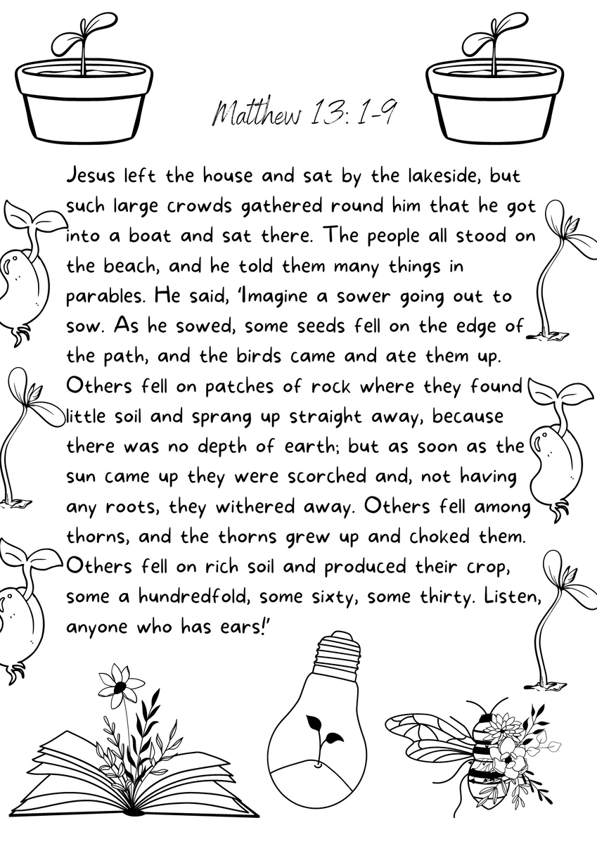
You are invited to attend Mass in any of the churches this weekend in the parish.
There will be a Rite for the Candidates for Confirmation.
You are asked to bring this page with you and you can find details in the Confirmation journal that you would have received with the Zoom link for this evening.
www.missionministry.ie

Slide 12
Closing Prayer
God of love,
we are brothers and sisters in Jesus your Son,
one family, in the Spirit of your love.
Bless us with the joy of love.
Make us patient and kind, gentle and generous,
welcoming to those in need.
Help us to live your forgiveness and peace.
Protect all families with your loving care,
Especially those for our own family whom we now pray:
[We pause and remember family members and others by name].
Increase our faith, strengthen our hope, keep us safe in your love,
Make us always grateful for the gift of life that we share.
This we ask, through Christ our Lord. Amen.
www.missionministry.ie

Slide 13


