Slide 1
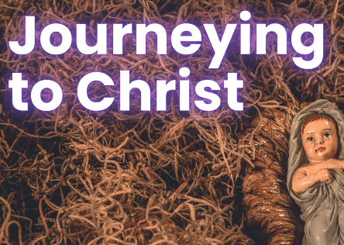
in preparation for:
1st Sunday
Advent 2023
GIFTED

Slide 2
GATHER
GIFTED
Take a moment to introduce yourself
and greet each other.
We pause for a moment
to prepare to listen to God’s Word
in preparation for:
1st Sunday
Advent 2023

Slide 3
HEAR
We listen now to words from St Paul’s first letter to the Corinthians
[1Cor 1:3-9]
“
GIFTED
May God our Father and the Lord Jesus Christ send you grace and peace.
I never stop thanking God for all the graces you have received through Jesus Christ.
I thank him that you have been enriched in so many ways, especially in your teachers and preachers; the witness to Christ has indeed been strong among you so that you will not be without any of the gifts of the Spirit while you are waiting for our Lord Jesus Christ to be revealed; and he will keep you steady and without blame until the last day, the day of our Lord Jesus Christ, because God by calling you has joined you to his Son, Jesus Christ; and God is faithful.
in preparation for:
1st Sunday
Advent 2023
”

Slide 4
REFLECT
May God our Father and the Lord Jesus Christ send you grace and peace.
I never stop thanking God for all the graces you have received through Jesus Christ.
I thank him that you have been enriched in so many ways, especially in your teachers and preachers; the witness to Christ has indeed been strong among you so that you will not be without any of the gifts of the Spirit while you are waiting for our Lord Jesus Christ to be revealed; and he will keep you steady and without blame until the last day, the day of our Lord Jesus Christ, because God by calling you has joined you to his Son, Jesus Christ; and God is faithful.
GIFTED
in preparation for:
1st Sunday
Advent 2023
What is the Word of God saying to you today?

Slide 5
REFLECT
GIFTED
in preparation for:
1st Sunday
Advent 2023
What are you noticing about the image?

Slide 6
REFLECT
GIFTED
St Paul talks about graces and gifts received - What graces and gifts do you have?
How do these graces and gifts enrich your life and the lives of others?
How can they help to reveal Jesus in this time of Advent waiting?
in preparation for:
1st Sunday
Advent 2023

Slide 7
pray
This week our time of prayer invites us to use our body & our imagination...
Take a moment to be still, sit comfortably, and focus your awareness on our God-with-us. You may wish to close your eyes to get rid of other distractions…
Sit with your hands clenched in a fist. Imagine that you hold within your grasp all your gifts, talents and experience. All this is yours and part of the person you are - Gifted by God. How does it feel to hold this treasure in your hands? Is there a particular gift you want to thank God for?...
Now be aware that, if you hold onto your giftedness like this, it is safe and protected from others, nothing can be taken away and it remains totally yours… but, if you continue to hold onto your giftedness like this, you are not able to receive more…
Will you consider taking the risk of slowly opening your hands? In doing so you open yourself to others taking from what you hold… but also you open yourself to receive even more.
If you are ready to make this choice, gently open your hands. Sit for a moment with your palms facing upward. Is there a gift you would like to ask God for today?
After a few moments with the Lord, slowly open your eyes.
Is there something you want to take with you from the time of prayer?
GIFTED
in preparation for:
1st Sunday
Advent 2023
We give thanks for our time of prayer as we say: Glory be to the Father, and to the Son, and to the Holy Spirit, as it was in the beginning, is now and ever shall be, world without end. Amen.

Slide 8
act
Having listened to the Scriptures, yourself and each other, as well as encountering God in prayer, is there something you feel you might do in response?
GIFTED
Choose a line from the Scriptures to pray with this week.
Make a list of your gifts and how you can use them
Affirm and thank someone if you see them share their giftedness
in preparation for:
1st Sunday
Advent 2023

