Slide 1
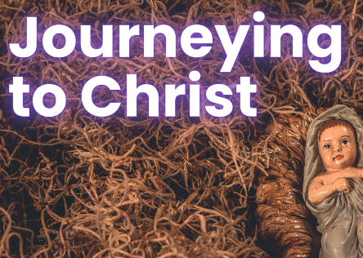
in preparation for:
2nd Sunday
Advent 2023
BAPTISED

Slide 2
GATHER
BAPTISED
Take a moment to greet each other and share anything that has stayed with you since last week.
We pause for a moment
to prepare to listen to God’s Word
in preparation for:
2nd Sunday
Advent 2023

Slide 3
HEAR
We listen now to words from the gospel of Mark [Mark 1:1-8]
“
BAPTISED
The beginning of the Good News about Jesus Christ, the Son of God. It is written in the book of the prophet Isaiah:
Look, I am going to send my messenger before you;
he will prepare your way.
A voice cries in the wilderness:
Prepare a way for the Lord, make his paths straight.
And so it was that John the Baptist appeared in the wilderness, proclaiming a baptism of repentance for the forgiveness of sins. All Judaea and all the people of Jerusalem made their way to him, and as they were baptised by him in the river Jordan they confessed their sins. John wore a garment of camel-skin, and he lived on locusts and wild honey. In the course of his preaching he said, ‘Someone is following me, someone who is more powerful than I am, and I am not fit to kneel down and undo the strap of his sandals. I have baptised you with water, but he will baptise you with the Holy Spirit.’
in preparation for:
2nd Sunday
Advent 2023
”

Slide 4
REFLECT
The beginning of the Good News about Jesus Christ, the Son of God. It is written in the book of the prophet Isaiah:
Look, I am going to send my messenger before you;
he will prepare your way.
A voice cries in the wilderness:
Prepare a way for the Lord, make his paths straight.
And so it was that John the Baptist appeared in the wilderness, proclaiming a baptism of repentance for the forgiveness of sins. All Judaea and all the people of Jerusalem made their way to him, and as they were baptised by him in the river Jordan they confessed their sins. John wore a garment of camel-skin, and he lived on locusts and wild honey. In the course of his preaching he said, ‘Someone is following me, someone who is more powerful than I am, and I am not fit to kneel down and undo the strap of his sandals. I have baptised you with water, but he will baptise you with the Holy Spirit.’
BAPTISED
in preparation for:
2nd Sunday
Advent 2023
What is the Word of God saying to you today?

Slide 5
REFLECT
BAPTISED
in preparation for:
2nd Sunday
Advent 2023
What are you noticing about the image?

Slide 6
REFLECT
BAPTISED
John preaches about the power of baptism - What does being baptised mean to you?
How has the Spirit of your baptism been active in your life and your relationships with others?
How can you activate your response to the call of your baptism during this time of Advent?
in preparation for:
2nd Sunday
Advent 2023

Slide 7
pray
This week our time of prayer invites us to engage again with our baptism...
BAPTISED
Take a moment to be still, sit comfortably, and focus your awareness on our God-with-us. If it helps, you may wish to close your eyes…
What do you remember about your baptism?.. Your godparents… the church you were baptised in… perhaps you have seen photos and can picture the scene?..
When you were baptised, the priest, your parents and godparents were invited to make the sign of the cross on your forehead….
This is a sign that marks us out as belonging to the community of Jesus Christ…
I now invite you to do the same and slowly trace the sign of the cross on your own forehead…
Be aware of what it means for you to be a member of Christ’s family…
In what ways do you… can you… will you… be an active member? What might Jesus be calling you to?
Is there something you want to take with you from the time of prayer?
in preparation for:
2nd Sunday
Advent 2023
We give thanks for our time of prayer as we say: Glory be to the Father, and to the Son, and to the Holy Spirit, as it was in the beginning, is now and ever shall be, world without end. Amen.

Slide 8
act
Having listened to the Scriptures, yourself and each other, as well as encountering God in prayer, is there something you feel you might do in response?
BAPTISED
Bless yourself with water each day this week as a reminder that you are baptised
Think of something you can do this Advent (and beyond) to put your baptism into action
Do something to prepare for the spiritual side of Christmas
in preparation for:
2nd Sunday
Advent 2023

