Slide 1
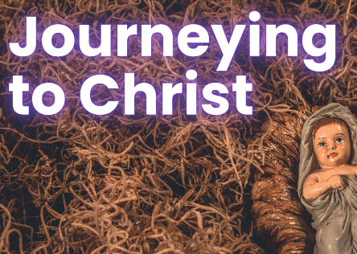
in preparation for:
3rd Sunday
Advent 2023
SENT

Slide 2
GATHER
SENT
Take a moment to greet each other and share anything that has stayed with you since last week.
We pause for a moment
to prepare to listen to God’s Word
in preparation for:
3rd Sunday
Advent 2023

Slide 3
HEAR
We listen now to words from the prophet Isaiah [Is 61:1-2, 10-11]
“
SENT
The spirit of the Lord has been given to me,
for the Lord has anointed me.
He has sent me to bring good news to the poor,
to bind up hearts that are broken;
to proclaim liberty to captives,
freedom to those in prison;
to proclaim a year of favour from the Lord.
‘I exult for joy in the Lord,
my soul rejoices in my God,
for he has clothed me in the garments of salvation,
he has wrapped me in the cloak of integrity,
like a bridegroom wearing his wreath,
like a bride adorned in her jewels.
‘For as the earth makes fresh things grow,
as a garden makes seeds spring up,
so will the Lord make both integrity and praise
spring up in the sight of the nations.’
in preparation for:
3rd Sunday
Advent 2023
”

Slide 4
REFLECT
The spirit of the Lord has been given to me,
for the Lord has anointed me.
He has sent me to bring good news to the poor,
to bind up hearts that are broken;
to proclaim liberty to captives,
freedom to those in prison;
to proclaim a year of favour from the Lord.
‘I exult for joy in the Lord,
my soul rejoices in my God,
for he has clothed me in the garments of salvation,
he has wrapped me in the cloak of integrity,
like a bridegroom wearing his wreath,
like a bride adorned in her jewels.
‘For as the earth makes fresh things grow,
as a garden makes seeds spring up,
so will the Lord make both integrity and praise
spring up in the sight of the nations.’
SENT
in preparation for:
3rd Sunday
Advent 2023
What is the Word of God saying to you today?

Slide 5
REFLECT
SENT
in preparation for:
3rd Sunday
Advent 2023
What are you noticing about the image?

Slide 6
REFLECT
SENT
The prophet recognises that they have been sent and missioned by the Lord - When have you recognised this in your own life?
‘In virtue of their baptism, all the members of the people of God have become missionary disciples’ (Evangelii Gaudium 120) - What does this mean to you?
How can you share in the mission of Jesus in this time of Advent?
in preparation for:
3rd Sunday
Advent 2023

Slide 7
pray
This week our time of prayer invites us to remember and pray...
SENT
Think of a time when you were aware of God speaking and calling you…
Was it a loud wake up call... difficult to miss… a message loud and clear?...
Or was it a spoken word… perhaps through the voice of a loved one or a stranger... speaking directly to your heart… even an answer to a prayer?…
Or was it a gentle whisper… almost missed… easy to ignore… maybe in a dream… bringing a sense of peace and a call to action?...
Spend a moment now, listening to God… and how you might be being called and sent TODAY...
We take a moment to repeat this simple missioning prayer a phrase at a time:
Jesus I believe in you,
Jesus I trust in you.
Lead me and guide me, this day,
to seek and do your will.
Is there something you want to take with you from the time of prayer?
in preparation for:
3rd Sunday
Advent 2023
We give thanks for our time of prayer as we say: Glory be to the Father, and to the Son, and to the Holy Spirit, as it was in the beginning, is now and ever shall be, world without end. Amen.

Slide 8
act
Having listened to the Scriptures, yourself and each other, as well as encountering God in prayer, is there something you feel you might do in response?
SENT
Pray the simple missioning prayer each day this week
Encourage someone to seek and follow the way of the Lord
Take part in some charitable work to respond to the needs of others
in preparation for:
3rd Sunday
Advent 2023

