Slide 1
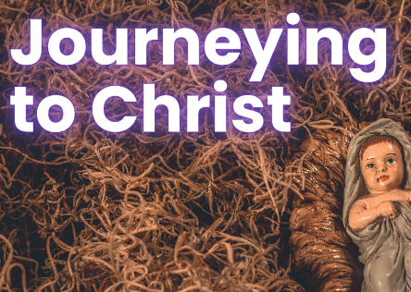
in preparation for:
4th Sunday
Advent 2023
RESPOND

Slide 2
GATHER
RESPOND
Take a moment to greet each other and share anything that has stayed with you since last week.
We pause for a moment
to prepare to listen to God’s Word
in preparation for:
4th Sunday
Advent 2023

Slide 3
HEAR
We listen now to words from the gospel of Luke [Luke 1:26-35, 37-38]
“
RESPOND
The angel Gabriel was sent by God to a town in Galilee called Nazareth, to a virgin betrothed to a man named Joseph, of the House of David; and the virgin’s name was Mary. He went in and said to her, ‘Rejoice, so highly favoured! The Lord is with you.’ She was deeply disturbed by these words and asked herself what this greeting could mean, but the angel said to her, ‘Mary, do not be afraid; you have won God’s favour. Listen! You are to conceive and bear a son, and you must name him Jesus. He will be great and will be called Son of the Most High. The Lord God will give him the throne of his ancestor David; he will rule over the House of Jacob for ever and his reign will have no end.’ Mary said to the angel, ‘But how can this come about, since I am a virgin?’ ‘The Holy Spirit will come upon you’ the angel answered ‘and the power of the Most High will cover you with its shadow. And so the child will be holy and will be called Son of God.’ ‘I am the handmaid of the Lord,’ said Mary ‘let what you have said be done to me.’ And the angel left her.
in preparation for:
4th Sunday
Advent 2023
”

Slide 4
REFLECT
The angel Gabriel was sent by God to a town in Galilee called Nazareth, to a virgin betrothed to a man named Joseph, of the House of David; and the virgin’s name was Mary. He went in and said to her, ‘Rejoice, so highly favoured! The Lord is with you.’ She was deeply disturbed by these words and asked herself what this greeting could mean, but the angel said to her, ‘Mary, do not be afraid; you have won God’s favour. Listen! You are to conceive and bear a son, and you must name him Jesus. He will be great and will be called Son of the Most High. The Lord God will give him the throne of his ancestor David; he will rule over the House of Jacob for ever and his reign will have no end.’ Mary said to the angel, ‘But how can this come about, since I am a virgin?’ ‘The Holy Spirit will come upon you’ the angel answered ‘and the power of the Most High will cover you with its shadow. And so the child will be holy and will be called Son of God.’ ‘I am the handmaid of the Lord,’ said Mary ‘let what you have said be done to me.’ And the angel left her.
RESPOND
in preparation for:
4th Sunday
Advent 2023
What is the Word of God saying to you today?

Slide 5
REFLECT
RESPOND
in preparation for:
4th Sunday
Advent 2023
What are you noticing about the image?

Slide 6
REFLECT
RESPOND
St Luke describes how Mary responds to God’s invitation - In what ways have you responded to God?
How might you respond differently this year to the invitation Christ’s birth brings to you and others?
How can you make a place for Jesus in this time of Advent waiting and in your Christmas celebrations?
in preparation for:
4th Sunday
Advent 2023

Slide 7
pray
This week our time of prayer invites us to be still and use our imagination.
RESPOND
Picture in your mind this encounter between Mary and the Angel… perhaps it happened in a room in the house… or by the well as she collected water… or walking in the street or fields… imagine the scene with as much detail as you can...
Now picture yourself in the scene… are you the Angel?... or Mary?... or perhaps an onlooker?...
What do you notice?... How do you react to what is being said?... How does this make you feel?...
In what ways does it change your understanding of this encounter?... What might be the message for you?...
Now bring your awareness back to where you are… bringing with you the insights from this experience…
Take a moment to be still with this and to ponder its significance for you...
Is there something you want to take with you from the time of prayer?
in preparation for:
4th Sunday
Advent 2023
We give thanks for our time of prayer as we say: Glory be to the Father, and to the Son, and to the Holy Spirit, as it was in the beginning, is now and ever shall be, world without end. Amen.

Slide 8
act
Having listened to the Scriptures, yourself and each other, as well as encountering God in prayer, is there something you feel you might do in response?
RESPOND
Be mindful of the presence of God in your encounters this Christmas
Think about how you respond to people this week
Spend some time asking God about the plans God has for you
in preparation for:
4th Sunday
Advent 2023

