Slide 1
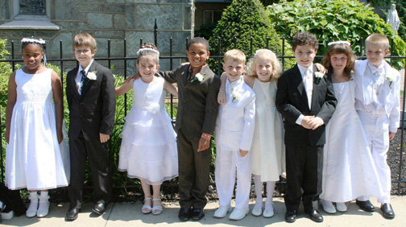
PARISH PARENT HELPS 3
PREPARING AS A FMAILY for FIRST HOLY COMMUNION

Slide 2
A PRAYER for PREPARING
Lord our God, as our family prepare in this year
We thank you for gathering us together in our home
We thank you for your goodness and kindness
We thank you for sending your Son Jesus
We thank you for his body and blood
We thank you for sharing this gift with us
For all the good things you give, we thank you.

Slide 3
REFLECT FOR YOURSELF
What does this prayer tell us about Mass?
Why is it important to say ‘Thank you’ in family life?

Slide 4
MASS: WHAT DOES IT MEAN TO YOU?
It’s a time when I get peace and quiet
I just come, I don’t know why but it helps me make sense of life
I don’t know if it means anything to me anymore
I feel pushed into being here, I find it really boring
It’s my time to say thanks to God
I know I’m praying with others, that gives me strength.
It’s my weekly space to stop and say thank you to God.
I’m part of this community, our Sunday Mass bonds us together
It helps me to stop and think, to remember God’s love, I can forget it when I’m busy during the week.
A group of parents were asked this question
These are there answers
Which of these answers is most like where you are just now?

Slide 5
SHARE THE MEMORIES at home
1. Have a chat with your child about why this year of preparation is a good opportunity to pray together as a family at Mass.
2. Get your own First Communion photos out, tell the story of the day, remember those who were with you and the happiness of the day.
3. Share what made it so special.
4. Create a small prayer area in your home with the pictures of your own first communion.
5. Give thanks for the help you were given by family and friends.

Slide 6
TEACH YOUR CHILD THIS YEAR
You can have chats at home about these faith actions and what helps us get the best out of Mass
1. To bless themselves when they enter Church for Mass
2. To join in some of the responses at Mass
3. To remember to pray for their family and friends
4. To join in any singing
5. To join in when everyone is standing, or sitting or kneeling.
1. To look at the altar when the priest holds up the host and the chalice
2. To hold hands for the Our Father
3. To say ‘Peace Be With You’ and shake hands
4. To remember that Jesus is with us in holy communion
5. To light a candle after Mass in thanksgiving

Slide 7
Take some time to LEARN THE WORDS OF THIS HYMN TOGETHER AS A FAMILY
Jesus took the bread he broke.
Jesus shared the bread he broke and said
Do this, do this in memory of me.
Jesus took the wine he poured.
Jesus took the wine he poured and said
Do this, do this in memory of me.

Slide 8
what images are striking you in this picture. How might this picture help you to speak about Mass with your child?

Slide 9
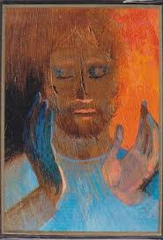
YOU CAN HELP YOUR CHILD
Take time to have chats at home throughout the time of preparation
By reminding them that Jesus gave his life for us
Telling your child that Holy Communion is a special time when we meet Jesus in person
Encouraging your child to say thank you often in prayer
At Mass on Sunday by helping them to join in
Renewing your own faith in this wonderful sacrament

Slide 10
REFLECT BACK NOW
PRAYER AT HOME
How easy or difficult would you find it to set up a small family corner where pictures of past First Communions are displayed?
Would you be able to find a cross and a candle for your family corner?
PRACTISE
What have your learned about the importance of practising faith actions?
Did you know that all the prayers the children need to know for Mass are at the back of their Grow In Love books?

