Slide 1
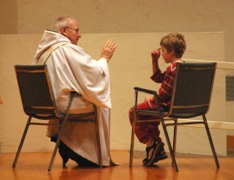
Parish parent helps 1
Preparing for reconciliation

Slide 2
WELCOME
This online resources has been prepared for parents to help you begin the journey of walking with your child as they prepare for the Sacrament of Reconciliation.
This will help you to:
Speak positively about God’s love to your child
Connect to moments of forgiveness in family life
Help you to reconnect in a positive way for yourself

Slide 3
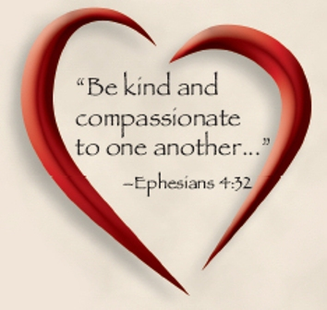
TAKE TIME TO PRAY
Loving God, help us to teach our children
that you love us totally and unconditionally.
Help us to encourage our children to grow in love
and to learn to say sorry
knowing that you always forgive.
Give us the courage to pray with our children
and to share our faith with them
as we journey together.
We ask this through Christ our Lord. AMEN.

Slide 4
YOUR OWN MEMORIES
Can you remember when you made your first confession?
What kind of preparation took place?
What was good and helpful about the experience?
What was difficult for you?
How do you feel about this sacrament now as an adult?

Slide 5
AN OPPORTUNITY
This time of preparation is an opportunity for you to have a positive experience of this sacrament.
It’s a sacrament of coming back together.
It’s a celebration of friendship restored.
It’s brings God’s healing into our lives and our relationships.
In this sacrament Jesus is saying ‘Give me another chance to love you.’

Slide 6
TOP TEN THINGS TO TEACH YOUR CHILD
1. That God never stops loving us
2. God’s love has no conditions no matter what
3. God is our personal friend
4. God always forgives when we say sorry
5. God does not remember our sins or keep a record of them
1. To thank God everyday in prayer for all that he does for us
2. To speak to God in their own words
3. To listen to God in moments of silence
4. To say sorry and then move on
5. To remember that God rejoices when we say sorry

Slide 7
REFLECT
Why do you think these messages are so important for your child to hear in this year?

Slide 8
PRAYER FOR GOING HOME
Listen to these words from the Gospel of Luke:
There is more joy in heaven over one sinner who returns home, than over ninety nine good living people who think they don’t need to come home.

Slide 9
Imagine this is God’s message for your family.
When you say sorry I rejoice
When you forgive I rejoice
When you tell the truth I rejoice
When you reach out to others in kindness I rejoice
When you love one another I rejoice

Slide 10
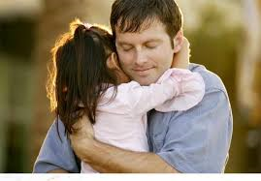
HOW YOU CAN HELP YOUR CHILD
Never speak of God as punishing
Encourage your child to say sorry often
Teach you child not hold grudges
Model this by saying sorry when you get it wrong
Build up habits of simple prayer
At Mass focus on the Lord have mercy, the Sign of Peace and the OUR FATHER
Continue to positively build up your child in love

Slide 11
IF YOU WANT MORE HELP
GO TO THE NEXT POWER POINT ABOUT RECONCILIATION OR HAVE A CHAT WITH A MEMBER OF YOUR PARISH TEAM ABOUT HOW YOU CAN CELEBRATE THIS SACRAMENT AS AN ADULT

