Slide 1
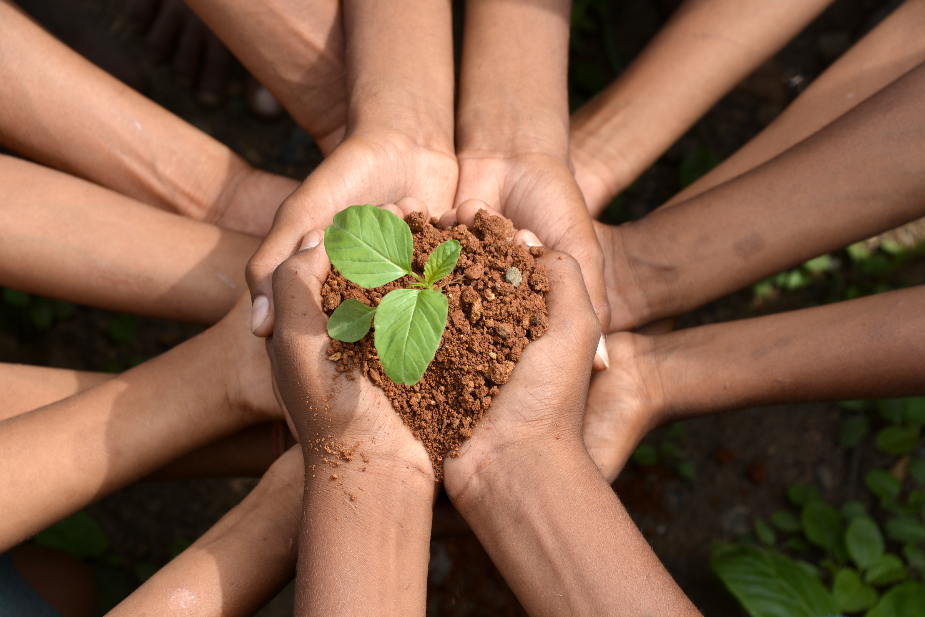
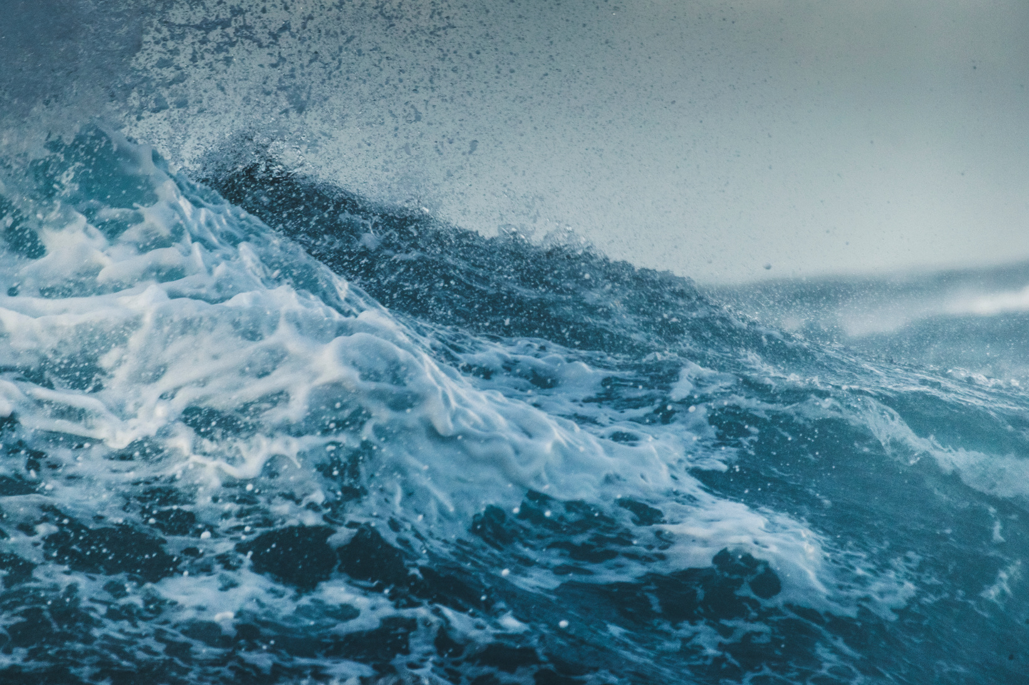
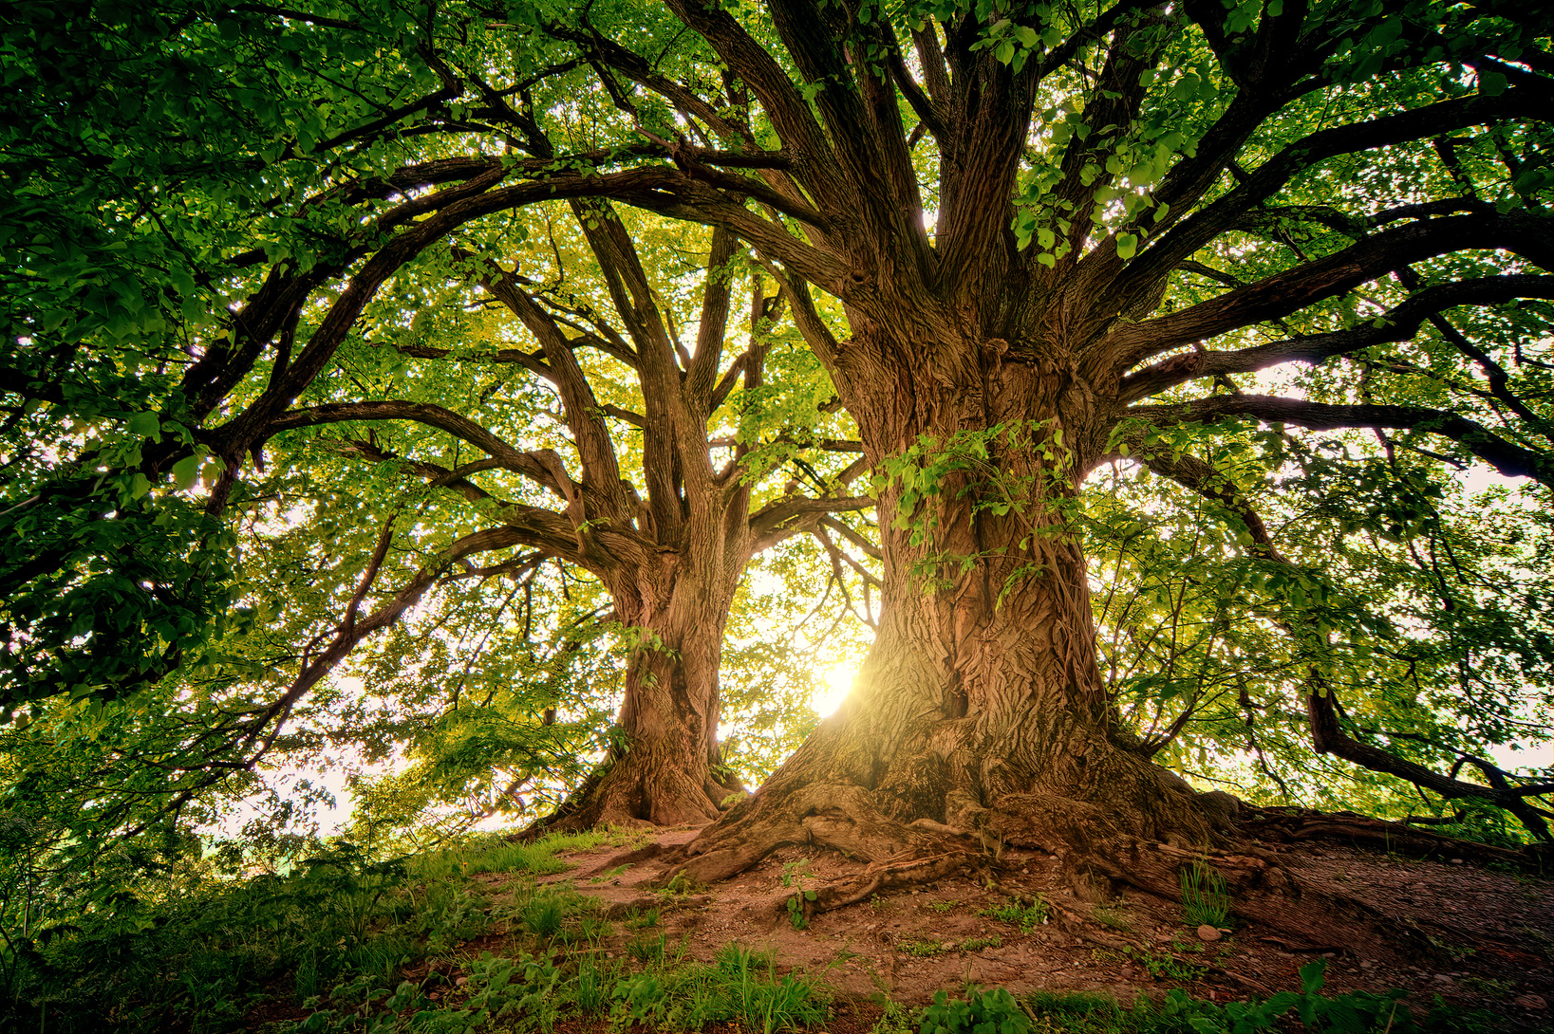
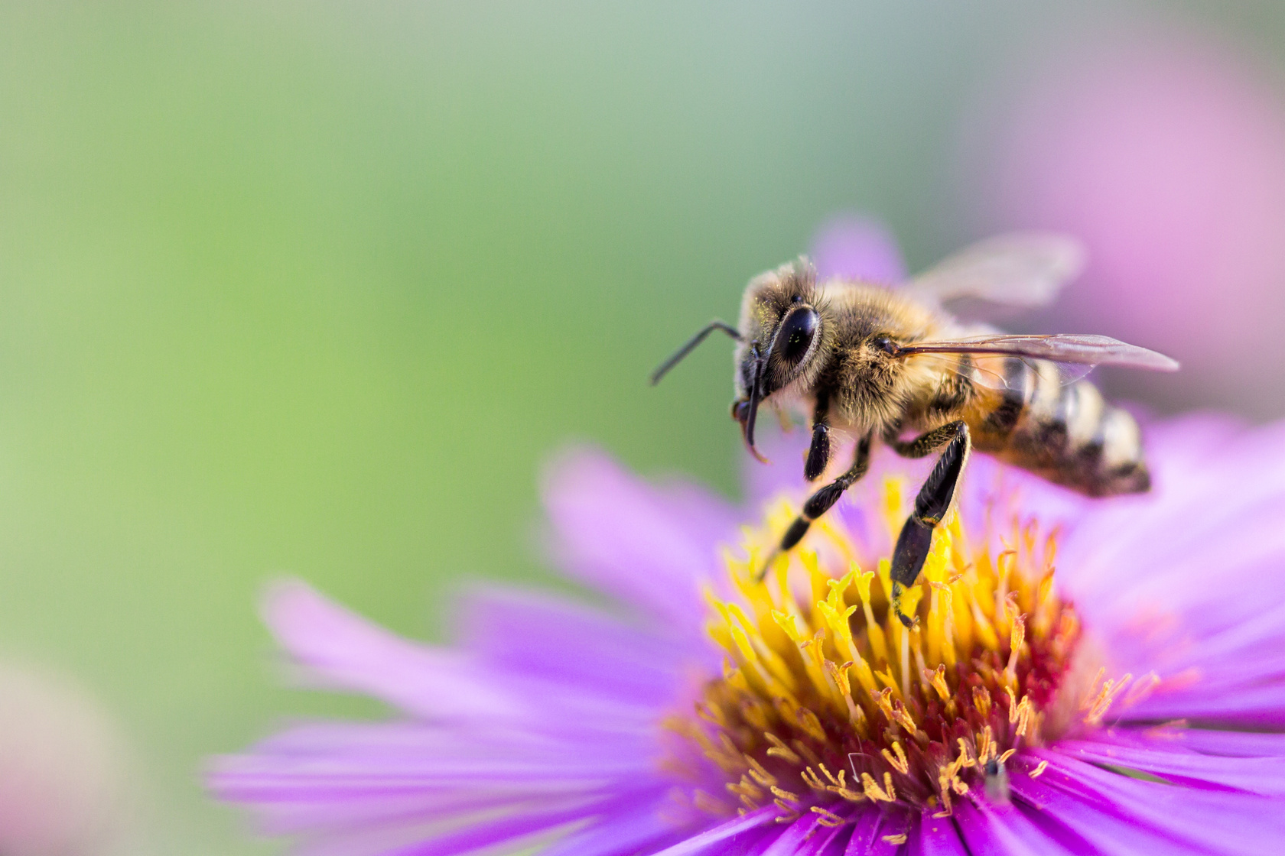




ARISE!
Laudato Si’
Bronze Award
Session 2
www.missionministry.ie

Slide 2


Slide 3
  Overview of the Award - what you need to do to get it
  What is Laudato Si’
  Looking at the world through the ‘Lens of Faith’
  All religions have a view point
  Story of Creation from the scriptures
  St Francis of Assisi
  Canticle of the Sun

Slide 4



What is the structure of a flower?
What is Pollination?
How does fertilisation happen?

Slide 5


Slide 8
Why do you think Pollination is important?

Slide 9
Share with the person next to you...
Why do you think Pollination is important?

Slide 11



Name different types of Pollinators...
Share with the person next to you...

Slide 12
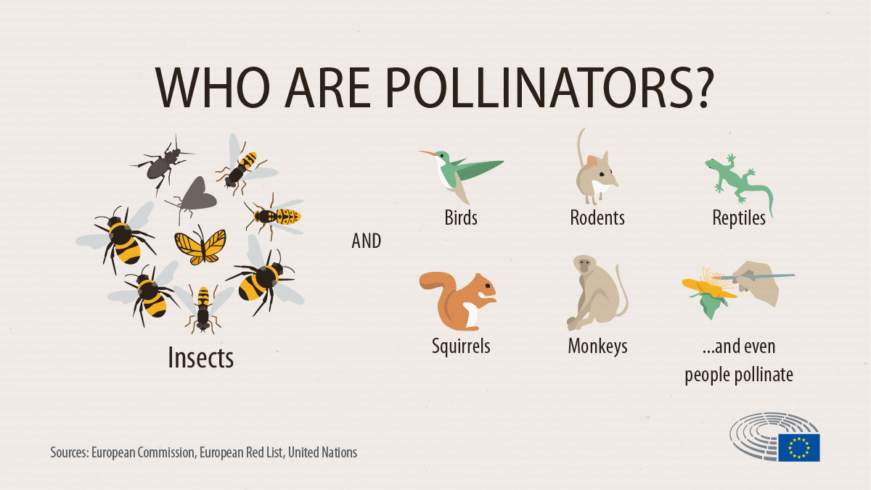

Slide 13


How can you help pollinators...?

Slide 14
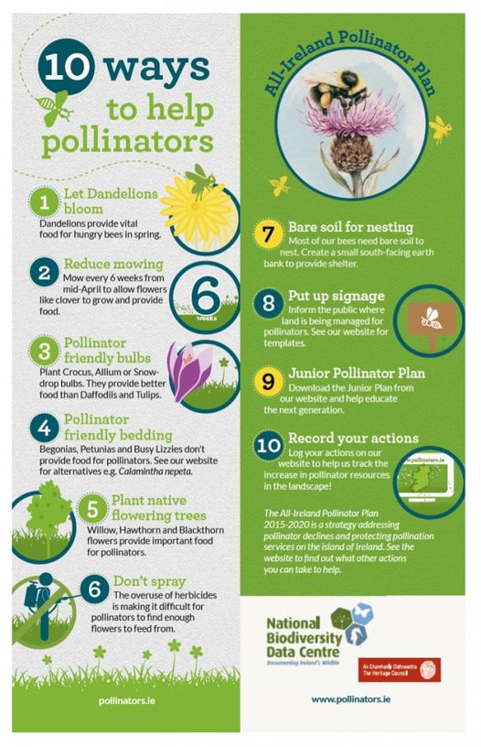

Slide 15
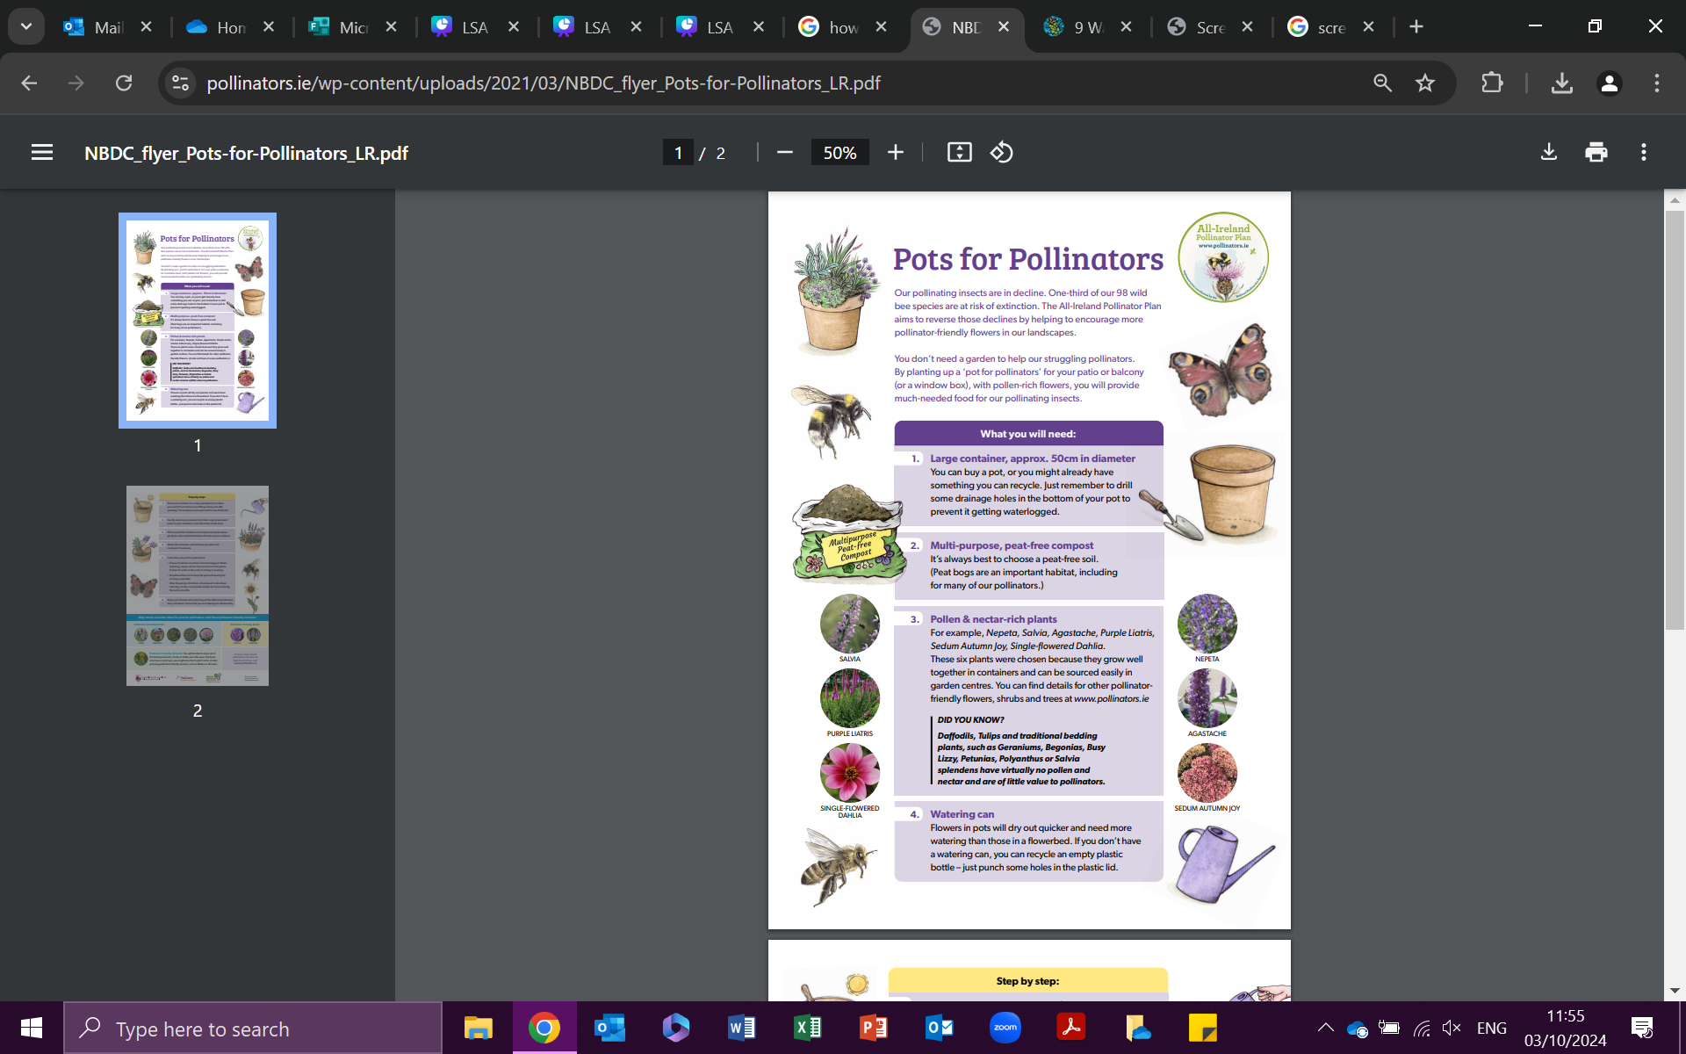

Slide 16
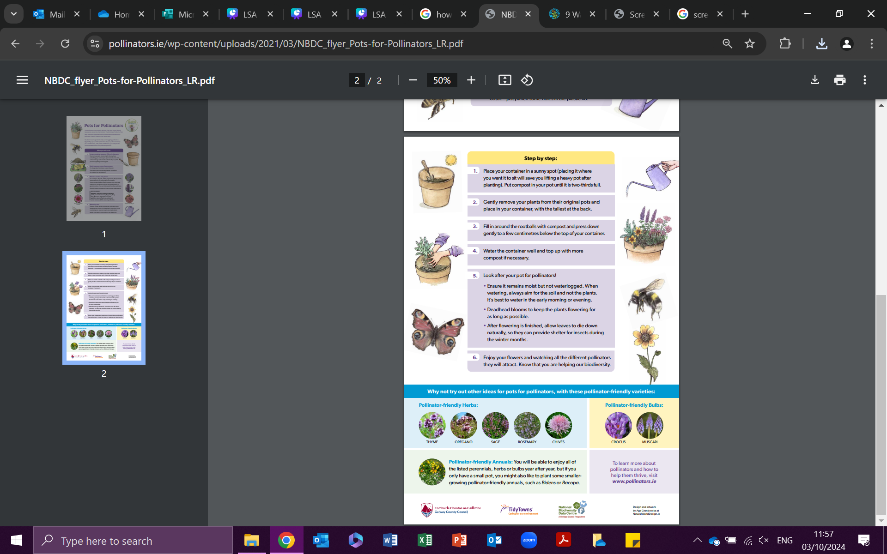

Slide 17
All-powerful God, you are present in the whole universe
and in the smallest of your creatures.
You embrace with your tenderness all that exists.
Pour out upon us the power of your love,
that we may protect life and beauty.
Fill us with peace, that we may live
as brothers and sisters, harming no one.
O God of the poor,
help us to rescue the abandoned and forgotten of this earth,
so precious in your eyes.
Bring healing to our lives,
that we may protect the world and not prey on it,
that we may sow beauty, not pollution and destruction.

Slide 18
Touch the hearts
of those who look only for gain
at the expense of the poor and the earth.
Teach us to discover the worth of each thing,
to be filled with awe and contemplation,
to recognize that we are profoundly united
with every creature
as we journey towards your infinite light.
We thank you for being with us each day.
Encourage us, we pray, in our struggle
for justice, love and peace.

Slide 19
ARISE!
natalie.doherty@dublindiocese.ie
www.missionministry.ie

