Slide 1
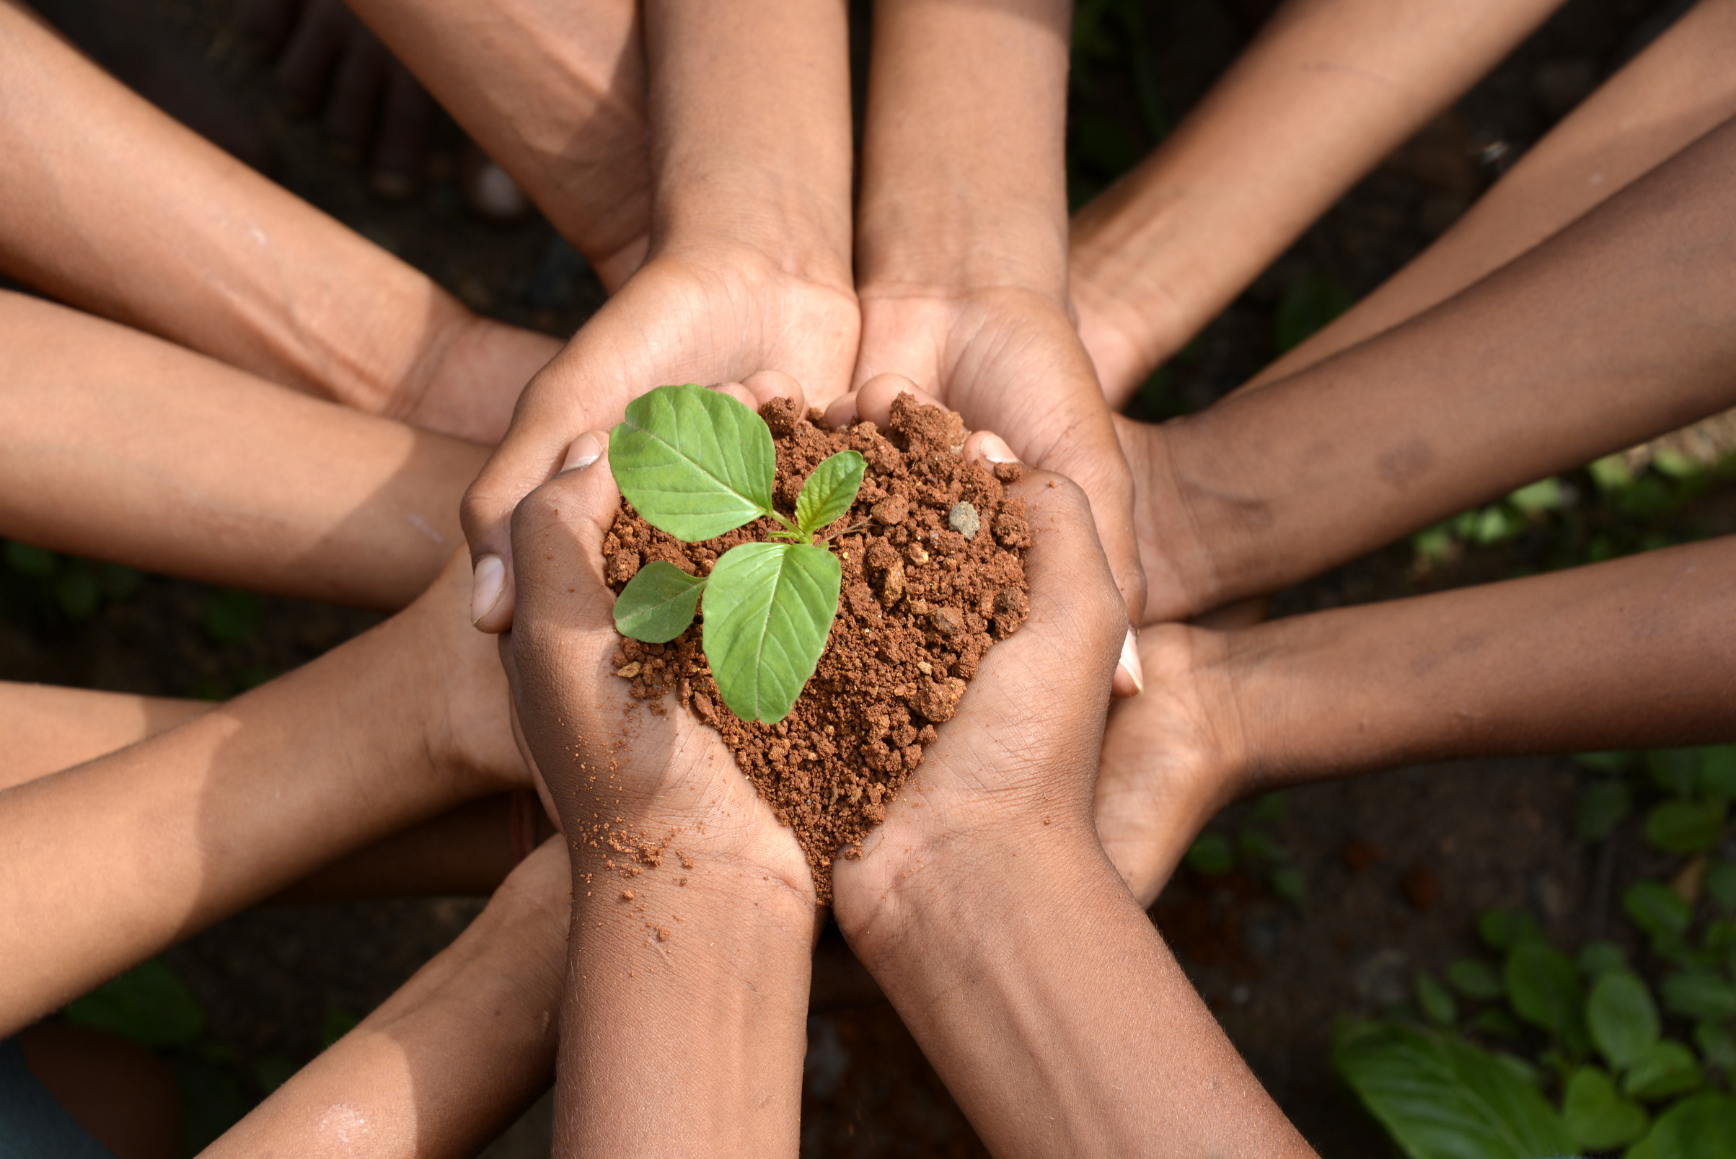
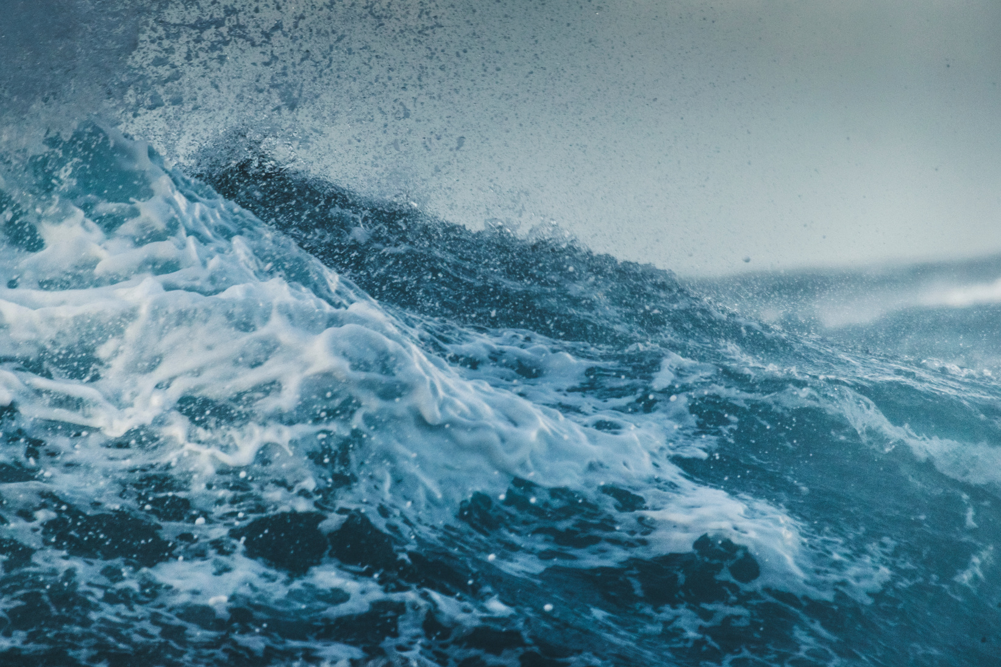
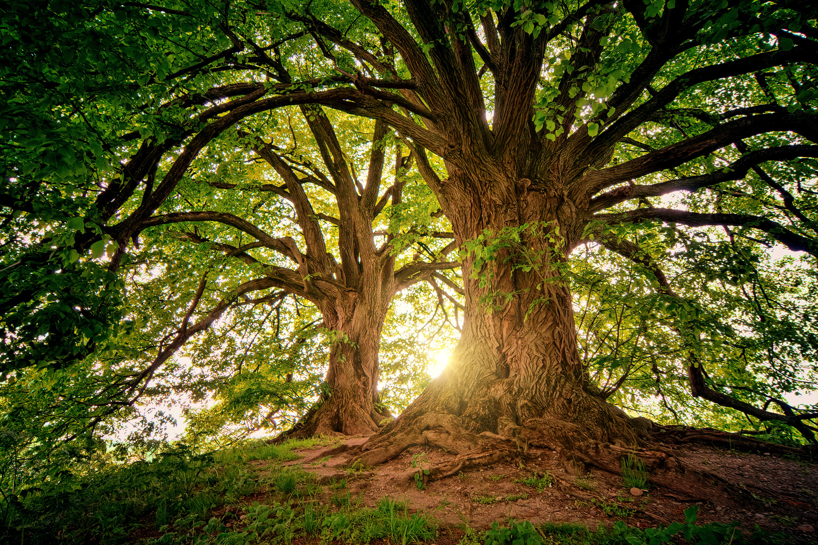
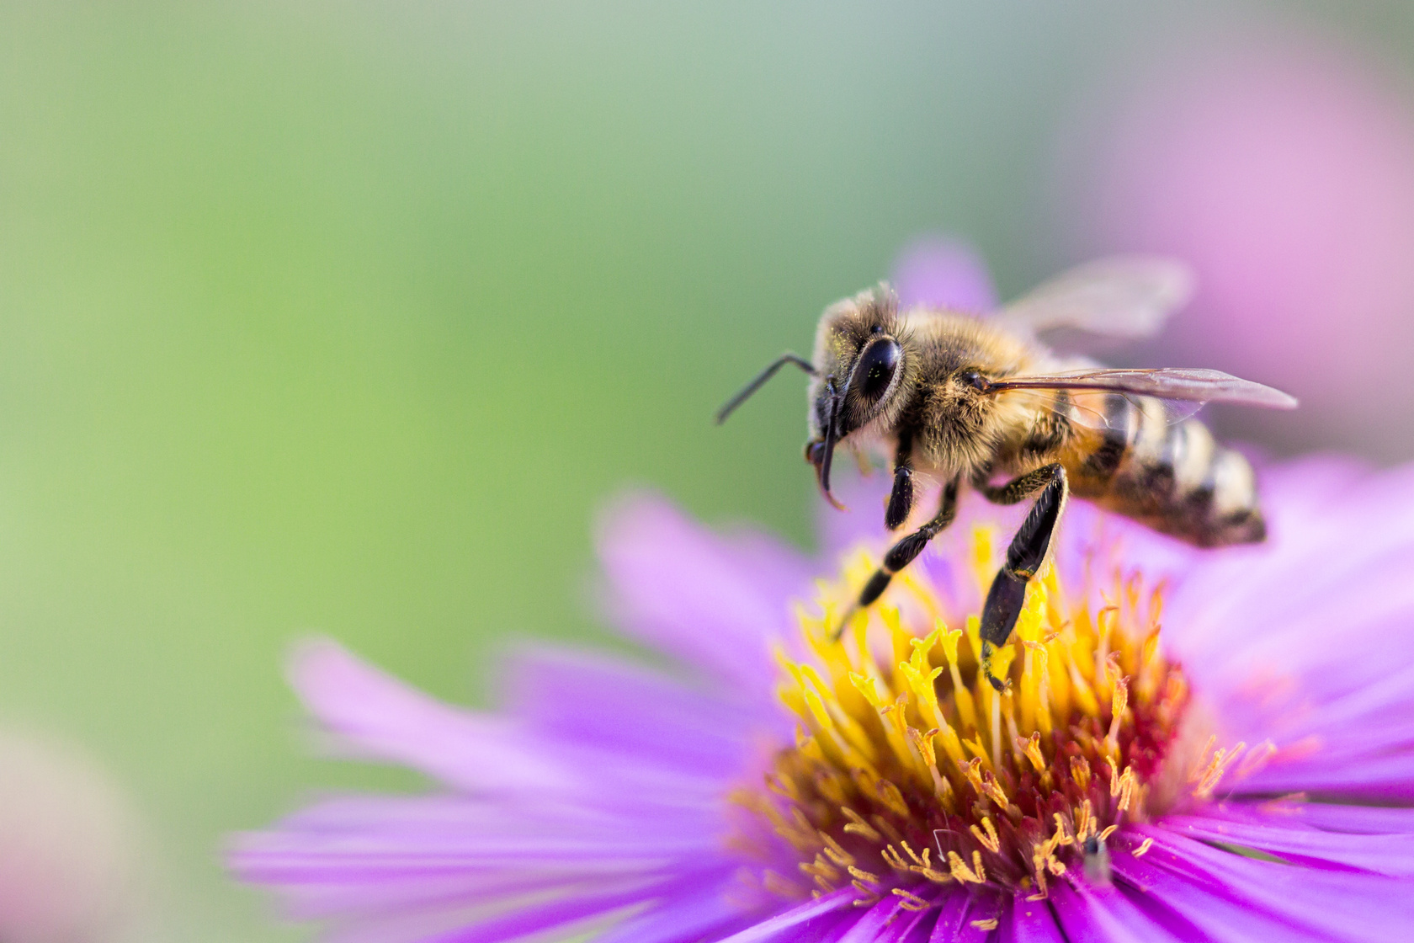




ARISE!
Laudato Si’
Bronze Award
Session 3
www.missionministry.ie

Slide 2


Slide 3
  What is Pollination?
  The structure of a flower
  Fertilisation and Seed Formation
  Importance of Pollination
  Types of Pollinators
  What you can do to help pollination

Slide 4

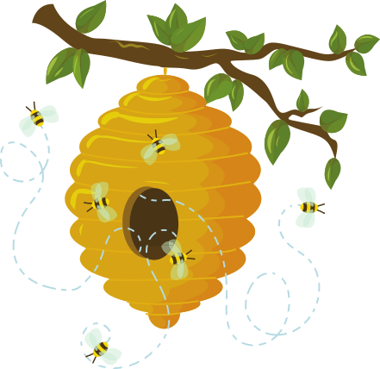
General Facts on Bees...
  There are 100 bee species in Ireland: the honeybee, 21 species of bumblebee, and 78 species of solitary bee.
  Bees are the most important pollinator of crops and native plant species in Ireland. They are a key component of our wildlife and one of the busiest, least appreciated work forces we have. A study from the Department of the Environment found that bees are worth €53m a year to the economy.
  In Ireland crops such as apples, strawberries, raspberries, tomatoes, blackcurrants, peppers, courgettes and pumpkins are reliant on bees for pollination.
  It is estimated that almost three quarters of our wild plants rely on insect pollinators, of which bees are most important.
  This www.pollinators.ie website provides information on the 99 native bee species, their decline, what needs to be done, and how you can help.

Slide 5
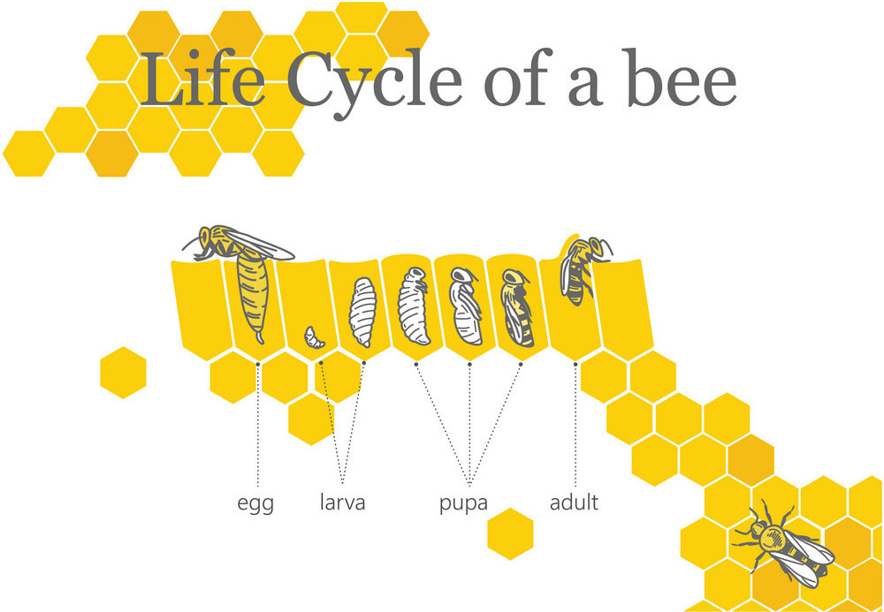

Slide 6

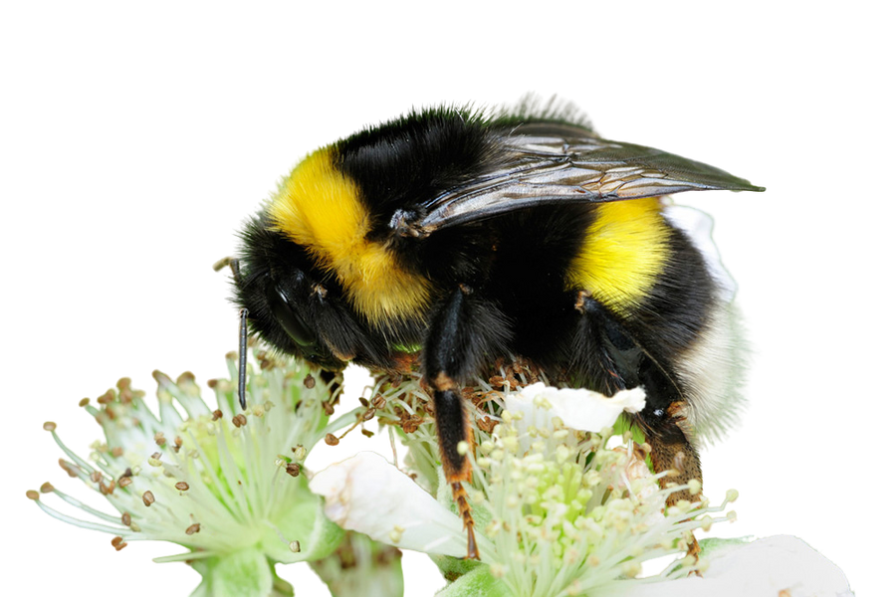

The Bumblebee

Slide 7


Slide 8
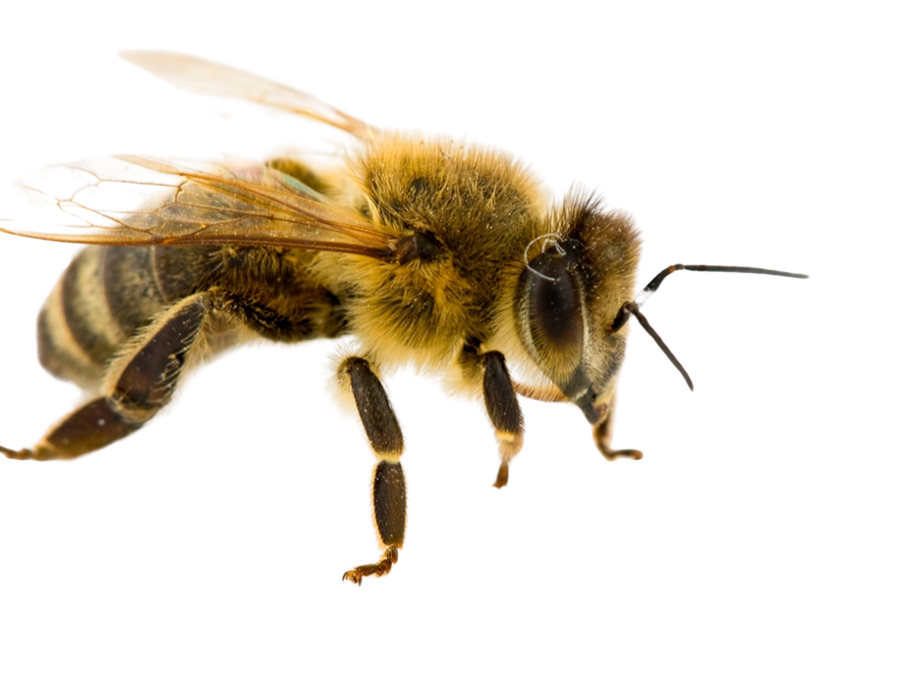
The Honey Bee

Slide 10
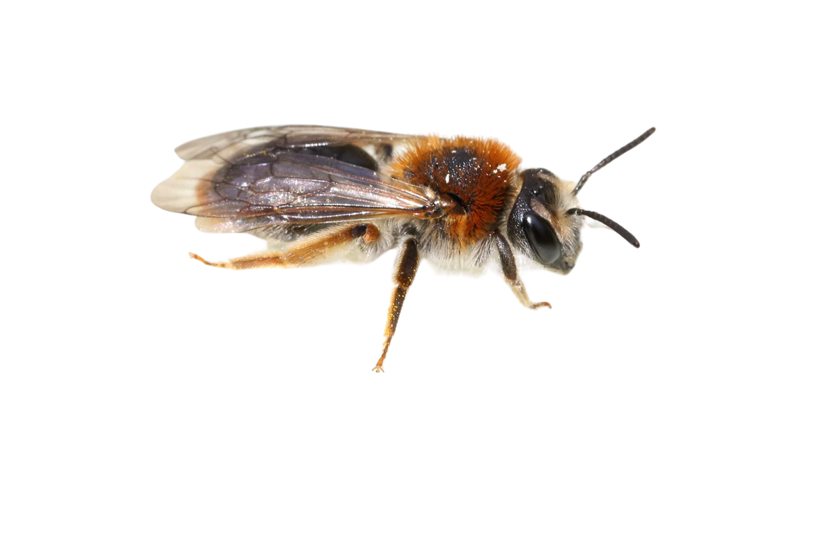
The Solitary Bee

Slide 12

Share with the person next to you...
Why are bees considered the greatest Pollinators?

Slide 14
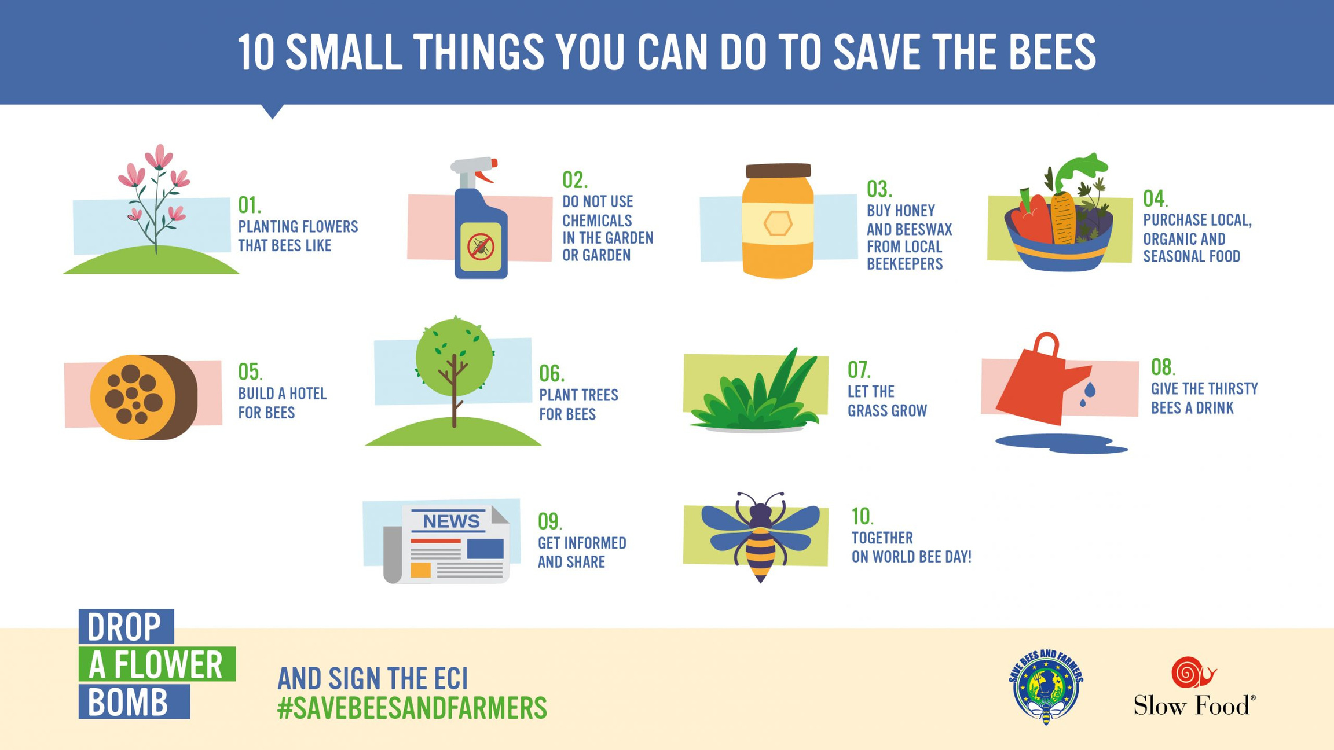

Slide 15
Father, we praise you with all your creatures.
They came forth from your all-powerful hand;
they are yours, filled with your presence and your tender love.
Praise be to you!
Son of God, Jesus,
through you all things were made.
You were formed in the womb of Mary our Mother,
you became part of this earth,
and you gazed upon this world with human eyes.
Today you are alive in every creature
in your risen glory.
Praise be to you!

Slide 16
Holy Spirit, by your light
you guide this world towards the Father’s love
and accompany creation as it groans in travail.
You also dwell in our hearts
and you inspire us to do what is good.
Praise be to you!

Slide 17
God of love, show us our place in this world
as channels of your love
for all the creatures of this earth,
for not one of them is forgotten in your sight.
Enlighten those who possess power and money
that they may avoid the sin of indifference,
that they may love the common good, advance the weak,
and care for this world in which we live.
The poor and the earth are crying out.
O Lord, seize us with your power and light,
help us to protect all life,
to prepare for a better future,
for the coming of your Kingdom
of justice, peace, love and beauty.
Praise be to you!
Amen.

Slide 18
ARISE!
natalie.doherty@dublindiocese.ie
www.missionministry.ie

